Slide 1
Players in the Global Community
World Issues 120

Slide 2
Nationalism and the Nation State
Each of us lives in a nation-state, and each of these nation-states plays a role in the way in which the global community operates.
The nation state defines "our territory", demands our loyalty and safeguards us against "our enemies".
National flags, national anthems and national histories promote a sense of pride and uniqueness among the citizenry of the nation.

Slide 3
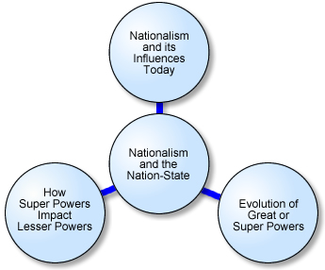

Slide 4
Nation and State
State — A sovereign political entity, having specific structure and institutions.

Slide 5
Any territory having the following characteristics would be internationally recognized as a sovereign state:
A specific, defined territory that it controls.
A resident population that are considered citizens.
An organized economy.
A system of finances and infrastructure to allow for the citizens to operate in an organized fashion.
A form of government internationally recognized as the legitimate "exerciser" of political power for the citizens and in control of the territory.

Slide 6
Nation and State
Nation — A (usually) large group of people who recognize and share one or more common cultural features, such as language, religion, ethnic background, historical experience, customs and/or values.
The concept of "nation" is not related to geography in the same way as is the state.
There are over 1400 nationalities in the world - each of which could be considered a nation.

Slide 7
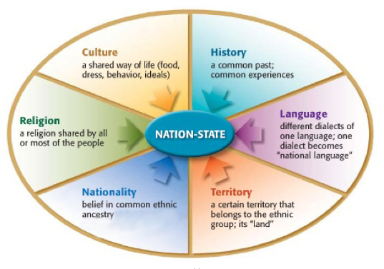
Nation-State
Nation-state - The term "nation-state" describes a concept of a state that is based on a single, recognizable nation.
Share a common language, ethnicity and cultural background.

Slide 8
When you consider that there are currently 191 countries in the world and over 1400 nationalities, you can see that many states contain numerous nationalities.
Complications: As global immigration increases and more people’s feeling of national identity is divided between the land of their birth, the place where they reside, the state in which they are a citizen, and so on.
Further complications: the term "nation-state" is often treated as a synonym of the terms "state," "nation," and "country”.

Slide 9
European States
Traditionally, European states structured themselves as nation-states though they didn’t structure it the same way when creating their empires into colonies and, later, into independent states.
Borders were set according to:
European treaties
Convenient geographical features
European trade relationships

Slide 10
Creating Conflict
Because of this, potential nations found themselves split by borders and grouped together with other, often hostile, nations.
As borders were expanded by countries (like England and Russia), they incorporated many nations within the borders of their growing states.
This has often led to a great deal of conflict between nations or nationalities contained within the borders of several of the new nation-states.

Slide 11
Consider this List:
Iraq - British colony containing Sunni and Shiite Arabs and Kurds
Rwanda - Belgian colony comprising Tutsi and Hutu tribes
Canada - British, French and Aboriginal people
New Zealand - British and Maori
Most Latin American nations - combination of Spanish and Aboriginal, with African added in
South Africa - native Bantu with native Zulu and British/Dutch white people moving in

Slide 12
True Nation-State?
A more recent study suggests that the true nation-state is very difficult to establish, with over 1400 "nationalities" recognized around the world.
This has led to the challenge of creating successful multi-cultural and multi-ethnic national states.
Many of them have been breaking-up (Yugoslavia & Soviet Union).

Slide 13
Nationalism
With over 1400 nationalities (nations) and only 191 nation-states, many nations work hard to establish a feeling of pride in being part of the nation-state.
The emotional feelings of patriotism and sense of belonging is called nationalism.
Promotes unity during times of crisis (times of war)
Can inspire economic development.

Slide 14
Pulling People Together
Nation-states will resort to an attempt to pull people together by creating a shared national identity
This is done through a common aspect - language, customs or history.
This is known as "national cultural integration" and has been used extensively in Western Europe and the United States.
Canada has gone in a different direction; creating a multi-cultural identity and building "nationalism" through the acceptance of our cultural diversities.

Slide 15
Nationalism – Identity vs. Melting Pot
A sense of nationalism can be helped or hindered by a nation's geography.
Example: If a country is an island like Japan or Britain or surrounded by mountains like Switzerland, it would seemingly be easier to build a sense of national identity versus a huge country like Canada, or a country such as Poland, which lies between Russia and Germany and has often been the center of invasion.
Ethnic Composition - again, if a country at least initially is settled by primarily a single ethnic group
Example: The Japanese people who share a common history, language and culture, may have an easier time building a sense of national identity versus a melting- pot nation like the United States, which is made up of many diverse groups who slowly were assimilated into an "American way of life".

Slide 16
Cold war
Superpowers at War
After World War II, the United States and the Soviet Union were the world’s strongest nations. They were superpowers. They had different ideas about economics and government. They fought a war of ideas called the Cold War. The Soviet Union was a communist country. In communism, the government controls production and resources. It decides where people live and work. The United States is a capitalist country. In capitalism, people and businesses control the production of goods. People decide where they live and work.
The Cold War began in Europe after World War II. The Soviet Union won control of Eastern Europe. It controlled half of Germany and half of Germany’s capital, Berlin. The United States, Britain, and France controlled western Germany and West Berlin. In June 1948, the Soviet Union blocked roads and railroads that led to West Berlin. The United States, Great Britain, and France flew in supplies. This was called the Berlin Airlift.

Slide 17
Cold War Conflicts
After World War II, Korea was divided into North and South Korea. North Korea became communist. South Korea was a capitalist country. North Korean army invaded South Korea. The United Nations sent soldiers to help South Korea. China sent soldiers to help North Korea. The war ended in 1953. Korea is still divided.
The United States and the Soviet Union were in a nuclear arms race. In 1959, Cuba became a communist country and the Soviets secretly put missiles there. President Kennedy was afraid the Soviet Union would attack the United States. He sent warships to surround Cuba. He hoped a blockade would force the Soviet Union to remove its missiles. This conflict was called the Cuban Missile Crisis. For six days, nuclear war seemed possible. Then the Soviet Union removed the missiles.

Slide 19
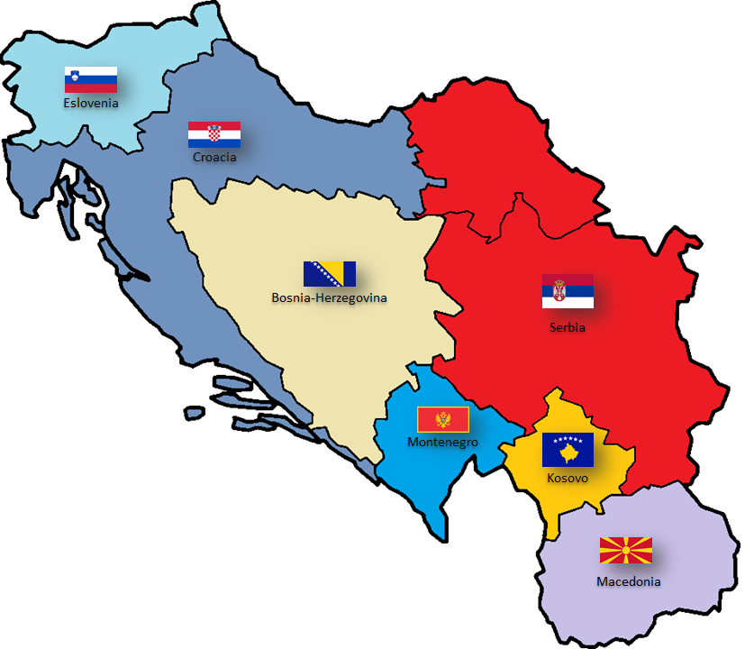
Nationalism Challenging Unity
When states fail to control it, nationalism can actually challenge the state's unity and lead to demands for division of the state.
For example: the former Yugoslavia
Boundaries are drawn to establish nation-states, but as nationalist forces continue to create chaos in various regions of the world, boundaries must change as new nation-states are created.
Political maps of the world seem to change almost on an annual basis.

Slide 20
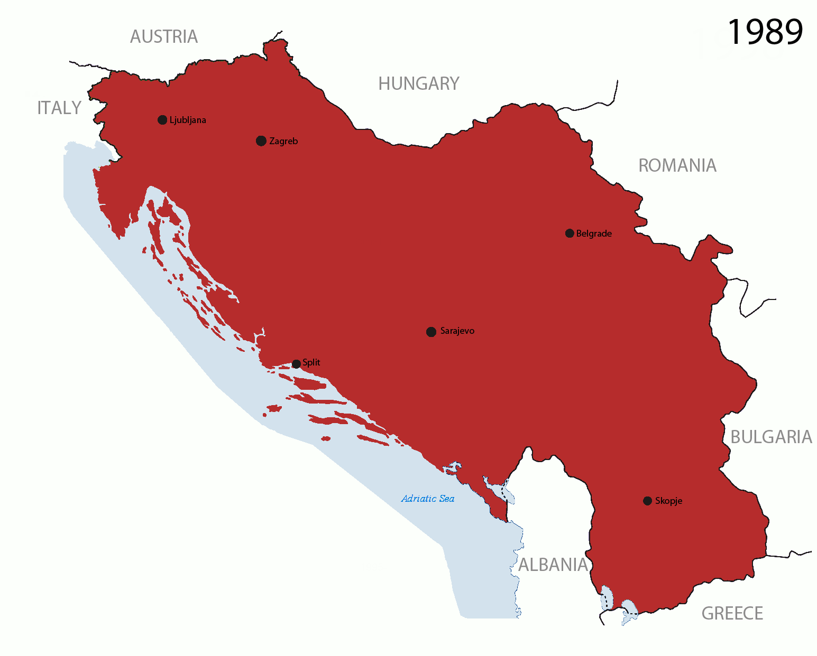
By Original by Hoshie; derivative by DIREKTOR - Made by DIREKTOR, see above for more details on sources, CC BY-SA 3.0, https://commons.wikimedia.org/w/index.php?curid=15851941

Slide 22
The United Nations estimates only 25 are free of separatist disputes out of its 191 member states.
Non-violent disputes include:
Quebec separatism (with the exception of a brief period in October, 1970)
The separation of most of the new states that formed after the break-up of the Soviet Union (USSR).

Slide 23
Civil War & Violence
The following are more recent examples of excessive "nationalism" that have led to excessive violence and/or civil war:
Sri Lanka - 1958 – present
Kurds (Turkey, Iraq, Iran) - 1984 - present
Basques (Spain) - 1960s – present
Northern Ireland - 1970s - present
East Timor - 1980s – 1998
Cyprus - 1960s - present
Eritrea (Ethiopia) - 1980s - 1990s
Sudan - 1970s – present
Chechnya (southern Russia) - 1990s - present

Slide 24
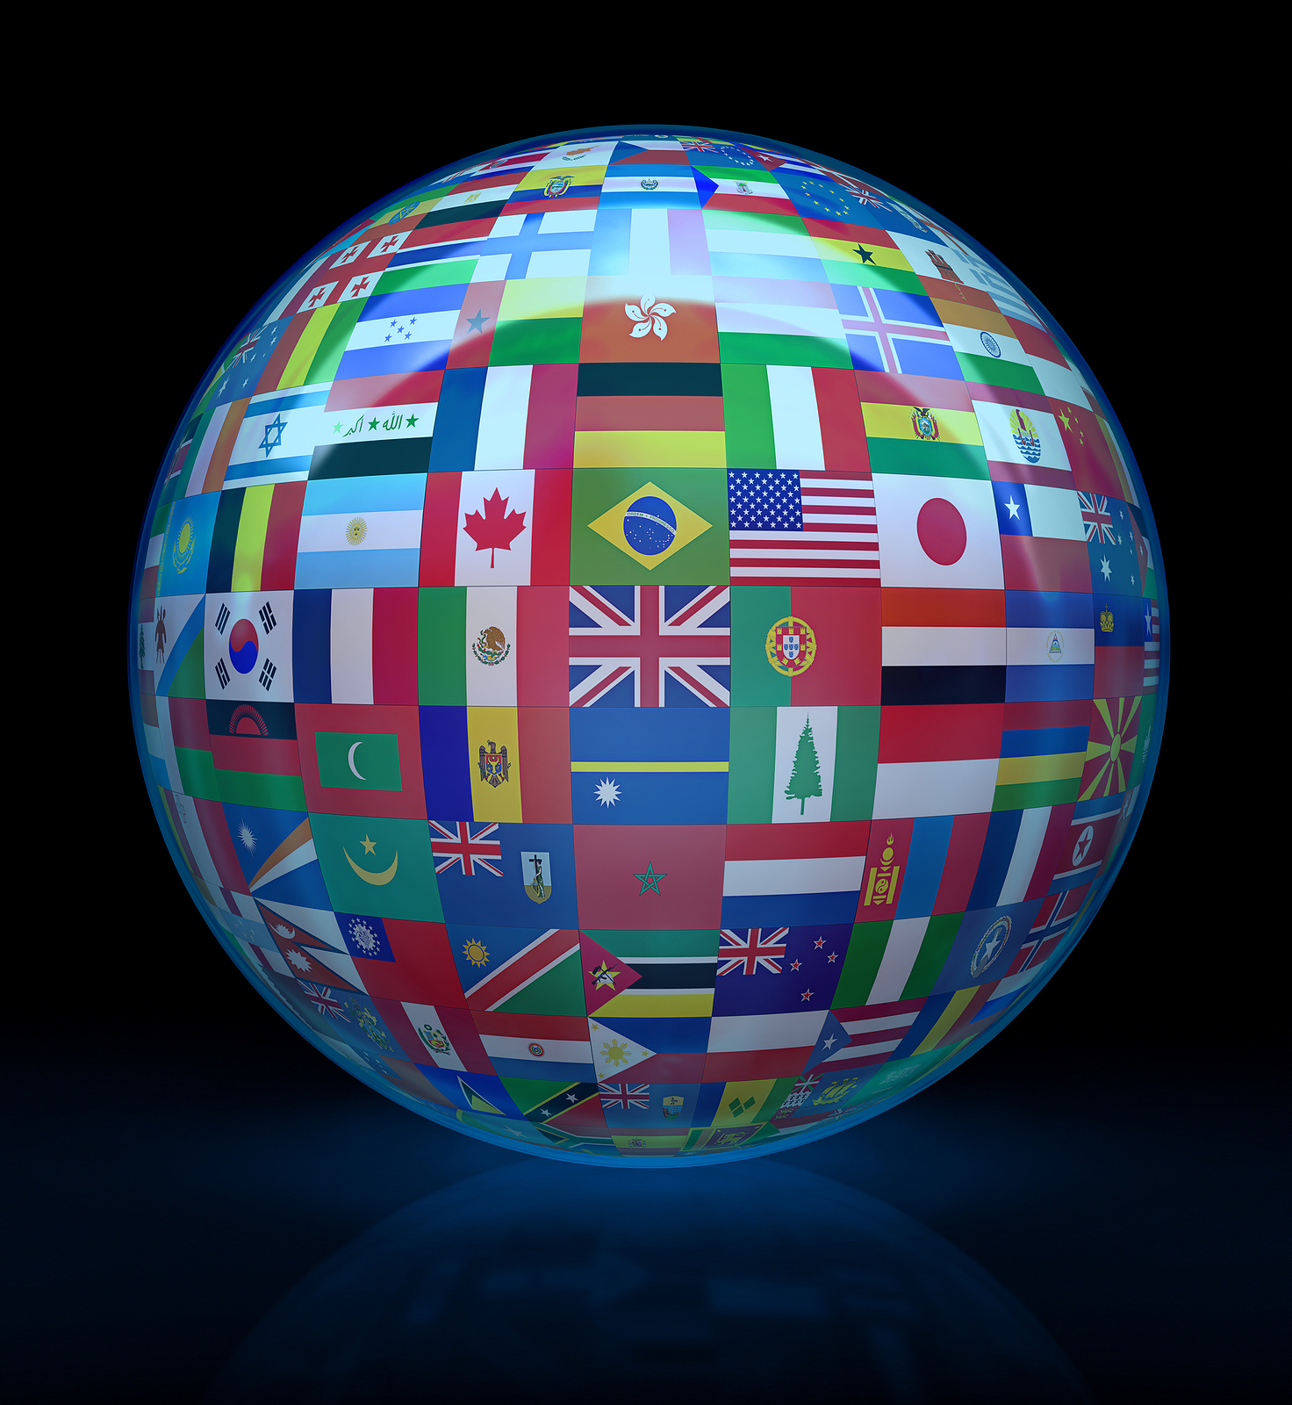
The effect of Globalization
Since World War II ended, the concept of globalization has laid an additional set of challenges on the very concept of the nation-state.
https://www.youtube.com/watch?v=xPD477FuqtY

Slide 25
Globalization
The process of extending to other (or all) parts of the world
Enabling financial and investment markets to operate internationally
Largely as a result of deregulation and improved communications.
* Globalization has resulted in the loss of some individual cultural identities
Marshall McLuhan
& Global village!

Slide 26
Economic Globalization
The move to eliminating obstacles to international trade (trade across borders).
That is to say to move toward a free and open trading system (neoliberalism – shift from public to private sector).

Slide 27
In Favour of Economic Globalization
Those in favour of economic globalization believe that by increasing trade with other countries of the world, it will lead the people of these less developed countries to greater prosperity. For example…
If Nike sets up a factory in Indonesia that makes sneakers, this provides Indonesians with jobs.
If Talisman Oil is in Sudan extracting oil, this is good for the Sudanese economy.

Slide 28
Arguments in favour of economic globalization:
By eliminating obstacles to trade, poorer countries have seen an improvement in their economies. In Asia, several countries have seen an increase in manufacturing jobs, eliminating the need for subsistence farming.
People have better access to knowledge. Political situations have improved because people have been exposed to democratic ideas.
Increased trade and investment spurs the growth of new industries, research and technologies.
Development projects funded by the Work Bank and International Monetary Fund have created jobs and have people to get better access to water, education, and health care.

Slide 29
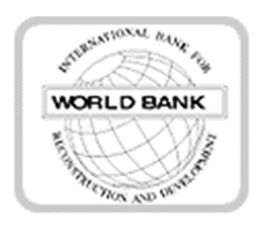
What institutions promote globalization?
The International Monetary Fund (IMF)
The World Bank (WB)
The World Trade Organization (WTO)
Multinational Corporations or Transnational Corporations
The governments of the developed world
On an individual level, generally speaking, those with a conservative worldview

Slide 30
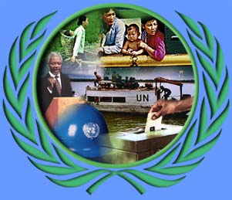
What Institutions are Against Economic Globalization?
Several agencies of the UN
UNCTAD – United Nations Conference on Trade and Development
UNDP – United Nations Development Programme
ILO – International Labour Organization
UNESCO – United Nations Education, Scientific and Cultural Organization
WHO – World Health Organization
The World Social Forum (WSF) - They oppose what they call, “corporate-dominated globalization”.

Slide 31
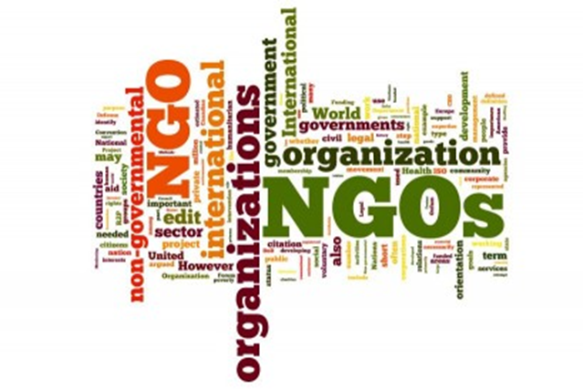
NGO’s: (Non-governmental organizations)
The Council of Canadians (Maude Barlow)
Amnesty International
Human Rights Watch
Medecins sans Frontieres
Friends of the Earth
Free the Children Movement
Peace Brigades International
Writers such as:
Michael Moore (Bowling for Columbine)
Naomi Klein (No Logo, Windows and Fences)
Avi Lewis
Stephen lewis
Noam Chomsky (Manufacturing Consent)

Slide 32
Arguments against globalization:
Mainly benefits the richer countries and the transnational corporations and increases the gap between the wealthy and the poor.
The income gap has increased in two ways: the gap has increased between rich and poor within countries and between countries. This gap more than doubled between 1960-1997.
Poor countries carry a heavy debt burden which forces them to cut support to essential services (education, health care, policing).
Negative impact on the world’s ecosystems – governments are restricted from passing laws to curtail degradation
Creating an American monoculture because of tele-communications systems and copyright laws.

Slide 33
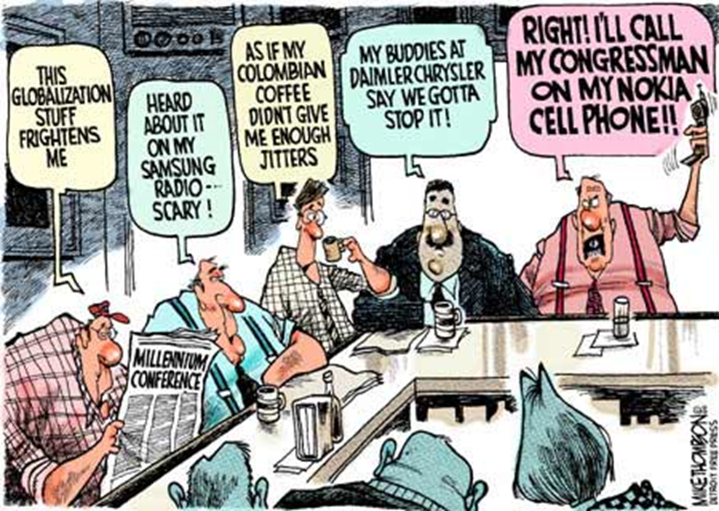

Slide 34
Division
Because industry has become international we now have a heightened division between the developed nations and the developing world.
This has increased many problems faced by the developing world:
rapid population growth
economic exploitation by multi-national corporations
rapidly mounting national debt
political instability

Slide 35
Anti-Immigrant?
Globalization has placed the United States as the world's leading economic power - this has created a very strong anti-American feeling throughout the world.
We now have rapidly growing migration levels into North America, Australia, and the European Union.
Which has led to the creation of border restrictions and an anti-immigrant feeling in the developed world.

Slide 36
Super Powers
In theory, all nations of the world are equal, but in practice, countries are classified on a spectrum
This ranges from least developed to middle, to "super" or "great" powers.
Super powers not only have moral and humanitarian leadership, scientific and cultural achievement, but they also have:
The ability to influence world affairs.
They have vast economic and military resources
They have both a large area and population.

Slide 37
Super Powers today
Arguably, the world's only super power since the collapse of the Soviet Union in 1990 has been the United States of America.
Other countries with characteristics of a super power include: China, Germany, Japan, Russia, France and Great Britain.

Slide 38
Middle Power
Canada is the world's second largest country by area, and has great economic strength and resources, but it is widely considered to be a middle power.
We lack military power, we cannot overtly influence world affairs, and-with a population of 32 million people - we are seen by the world community to be under populated for our size.

Slide 40
Peace & Security Among Nations

