Slide 1
Types of
Musical Groups and Ensembles

Slide 2
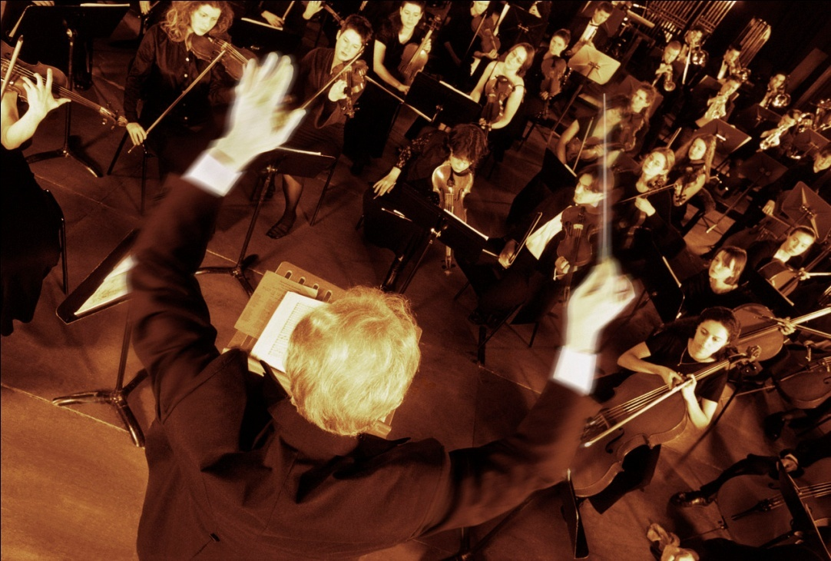
Symphony Orchestra
The group is actually an orchestra – it is often called a Symphony Orchestra because it is an orchestra that plays symphonies.
link

Slide 3
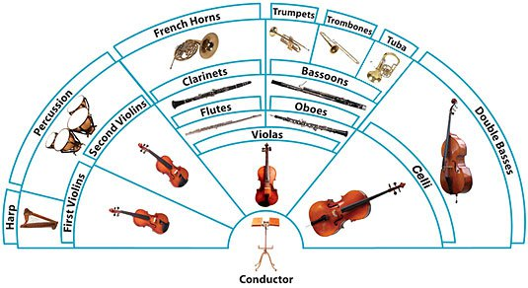
Symphony Orchestra

Slide 4
Numbers (Strings)
On average, orchestras have:
16 violins
8 violas
6 cellos
2-3 double basses

Slide 5
Numbers (Woodwinds)
2 flutes and a piccolo
2 clarinets and a bass clarinet
2 oboes
2 bassoons

Slide 6
Numbers (Brass)
4 French Horns
3 Trumpets
3 Trombones
1 Tuba

Slide 7
Numbers (Percussion)
The average orchestra has 2-3 percussionists who play:
Timpani
Snare drum/Bass drum
Xylophone/Orchestra Bells
Other percussion as required

Slide 8
Reflection
On looseleaf, create a paragraph that addresses the following questions (to be passed in):
Is it “ok” for orchestras to cover songs from other genres? Does it work?
If the situation were reversed – would it be ok?
If you were the original songwriter, would you mind?

Slide 9

Concert Band
A concert band is similar to an orchestra with one exception:
There are no string instruments found in a concert band (with the possible exception of electric bass).

Slide 10
Woodwinds in a
Concert Band
Piccolo and flute
Clarinet and bass clarinet
Oboe and bassoon (not usually english horn or double bassoon)
Saxophones – soprano, alto, tenor, baritone

Slide 11
Brass in a
Concert Band
Trumpets
French horns
Trombones
Euphonium (small tuba)
Tuba

Slide 12
Percussion in a
Concert Band
Drum set
Snare drum and bass drum
Crash cymbals
Bells, xylophone, marimba
Tympani
“Toys” such as triangle, sleigh bells, tambourine, castanets, cabasa, etc

Slide 13
Number of Players in a
Concert Band
There is no fixed size of a concert band, but you will usually find 40-60 players in a typical concert band.
Some smaller communities may only have 12-15 musicians in their band!

Slide 14
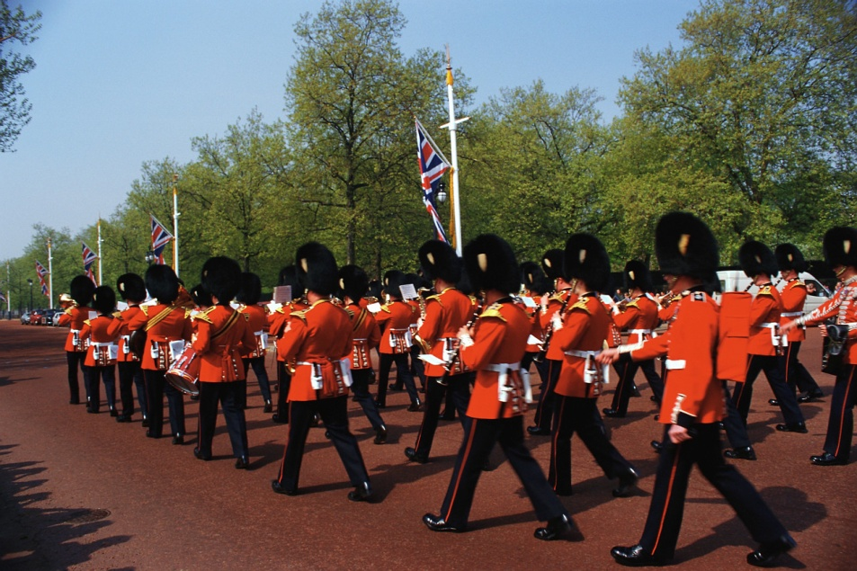
Marching Band
A marching band may have from 20 to 500 musicians!
It will be led by a drum major with a mace, who uses the mace to give signals regarding where and when to march.

Slide 15
Instruments in a
Marching Band
Similar to a concert band with the following exceptions:
The percussion must be mobile – therefore, no drum set. Snare drums, bass drums, cymbals, and glockenspiels are most common.

Slide 16

Marching Band
Oboes and bassoons are rare.
Sousaphones may be used instead of tubas.
The trombones are always in the front row…Why?

Slide 17
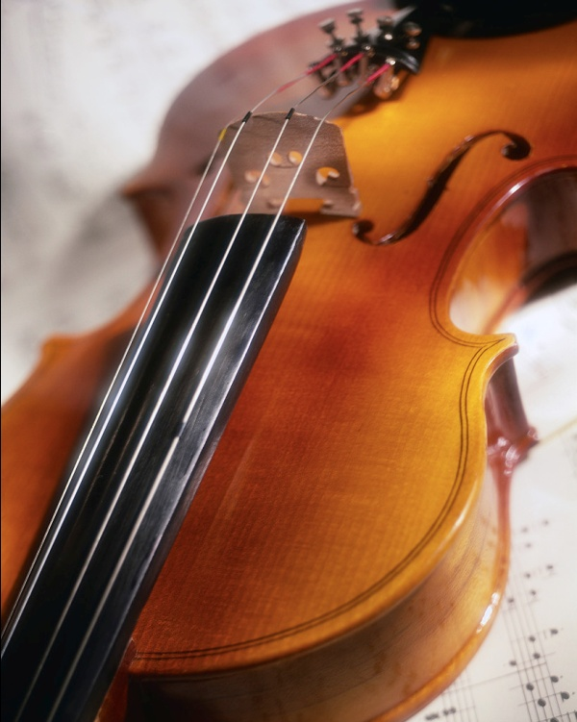
String Quartet
2 violins, 1 viola, 1 cello
There are two violins
because harmony
sounds better in higher
ranges than lower.
The string quartet was a favourite ensemble of many composers.

Slide 18
Brass Quintet
2 trumpets, 1 french horn, 1 trombone,
1 tuba.

Slide 19
Woodwind Quintet
Flute, clarinet, oboe, bassoon, and French horn (which is really a brass instrument!).
The French Horn, because it is so mellow, serves to blend the sometimes shrill sounds of the woodwinds.

Slide 20
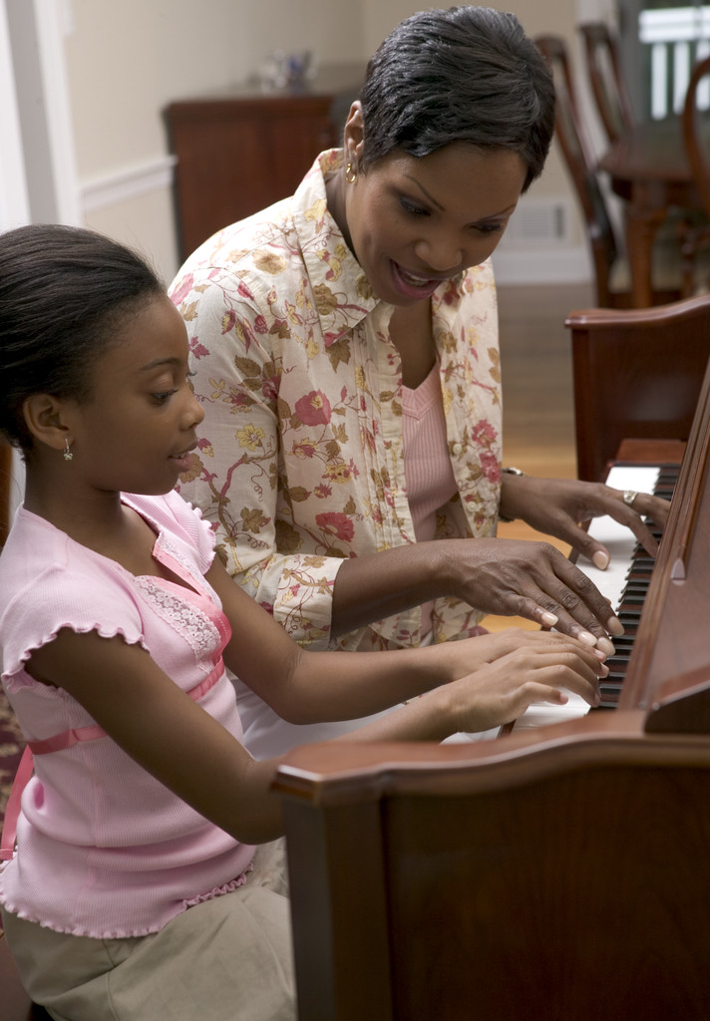
Piano duet
One piano, 2 players

Slide 21

Piano Duo
2 pianos, 2 players

Slide 22

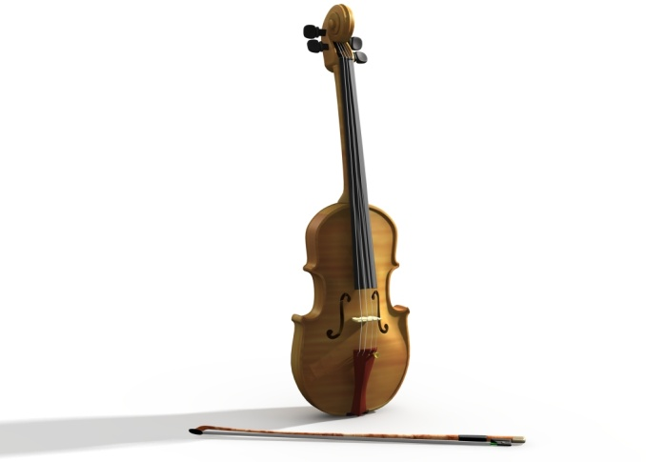
Piano Trio
Piano, violin, cello

Slide 23
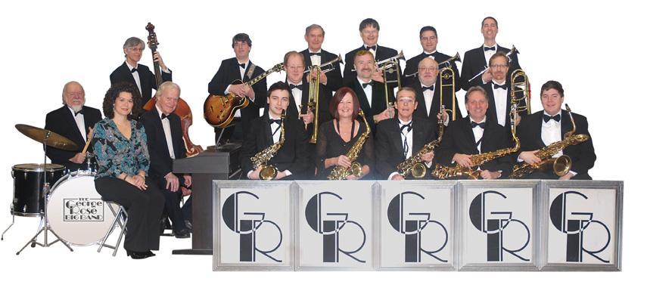
“Big Band”
Big bands became popular as a result of the growth of jazz and swing music.

Slide 24
“Big Band”
A Big Band usually consists of:
5 saxophones
4 trumpets
4 trombones
The “rhythm section”: piano, guitar, bass and drums.
Sometimes a vocalist will be featured, but they are not necessary. link

Slide 25
Combos
Duo: any two instruments
Trio: Any three instruments
Quartet: Any four instruments
Quintet: Any five instruments
Sextet: Any six instruments
Septet: Any seven instruments
Octet: Any eight instruments

