Slide 1
Global interdependence
World Issues 120

Slide 2
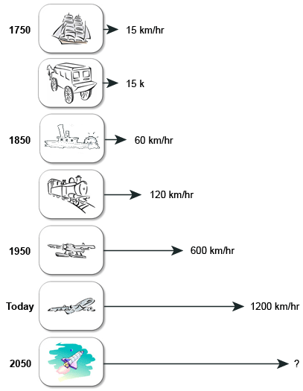
Technological revolutions
Global Interdependence has expanded hand-in-hand with the growth of technology.
Since the end of World War II (1945) the world has become a smaller place because of technological revolutions. (Communications and transportation)
In a matter of hours or minutes, we can travel to destinations around the world that a century ago would have taken weeks or months!
Space shuttles
Supersonic aircraft
Automobiles
Multi-lane highways

Slide 3
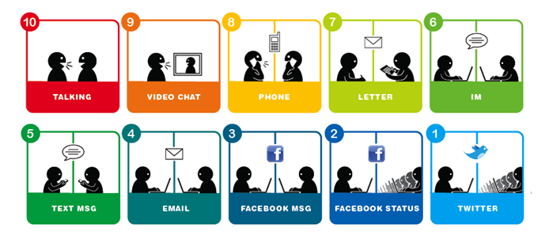
Global communication
Transistor radio and TV made the world reachable (in the 1950s and 1960s)
In the past two decades global communication has become virtually instantaneous with:
Satellite communications
Cell phones
Fax machines
Personal computers
The internet

Slide 4
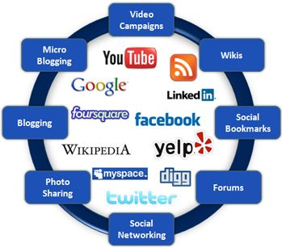
Telecommunication Revolution
One of the first individuals to recognize this revolution was a Canadian, Marshall McLuhan.
An English professor and director of the Center for Culture and Technology at the University of Toronto during the 1960s.
His contributions to the field of communications made him one of the most influential communications theorists of the 20th century.
https://www.historicacanada.ca/content/heritage-minutes/marshall-mcluhan?media_type=41&media_category=
*Media (or singular medium) is the collective communication outlets or tools that are used to store and deliver information or data.

Slide 5
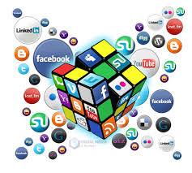
The Medium is the Message: Assignment
Write a paragraph (about 300 words) describing what medium you think is the most important for you and why. Be specific.
Many devices can be used in multiple ways.
Pick the one communication tool, such as texting or Twitter, that you think is the most important.
How does this medium influence the message that is being sent?
Who are you usually communicating with?
Would you pick a different tool to communicate with other people?
Has your choice resulted in today's young people having more or less contact with each other than your parents did when they were teenagers?
Remember to give reasons and specific examples to support your positions.

Slide 6
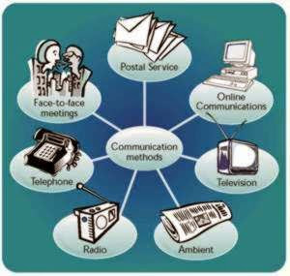
The Global Village
Arguably, global culture in the 1980s was shaped by television.
McLuhan also believed that the linking of electronic information media would create an interconnected "Global Village".
Advances in technology help people all over the world to have better access to each other and, in a sense, make our planet smaller than it is.
The "Global Village" is shaped by electronic media, transportation can also be considered a factor in the creation of a "global village".

Slide 7
Types of Global Interdependence
Global interdependence: the mutual reliance of two or more countries upon each other for basic goods and services.
Early humans - self-sufficient, made up of nomadic hunters and gatherers who roamed within very small areas.
Early western civilization - trade, military and social relationships were confined to an area that for the most part, encircled the Mediterranean Sea.
Today – due to technological advancements made since WWII global communication and transportation are now everyday events.

Slide 8
Types of Interdependence
Today, global interdependence can be divided into the following seven types of interdependence:
Technology
Natural resources
Agriculture
Distribution of goods and services
Information
Military Affairs
Economies
Global interdependencies can be very complex or very simple in nature. It is also true to say that these interdependencies touch the lives of practically every human being on earth.

Slide 9
Examples of Global Interdependence
Looking at the various interdependencies that are involved in a simple trade relationship between Canada and China, in which Canada trades wheat to China in exchange for rice.
Here are a few interdependencies involved:
The exchange of wheat for rice is an example of agricultural interdependence.
The means by which the food is transported between Canada and China (truck, train, ship or plane) is an example of distributional interdependence.
The information systems required to keep the wheat and rice moving to the right place, at the right rate and at the right time is an example of informational interdependence.
*This simple example shows how interdependencies are linked.

Slide 10
Examples of Global Interdependence
With this in mind, consider informational interdependence in today's "information age."
Government and business decisions can rely on information ranging from basic data received from foreign sources to highly classified military intelligence gathered near enemy lines.
In this way, informational interdependence is linked to economic interdependence and military interdependence.
The exchange of military information is also critical to military interdependence.
There have been military alliances for thousands of years, and today, military interdependence still plays a major role in international affairs.
For example, the defense of Canada and the United States since the end of World War II has been based on the North Atlantic Treaty Organization (NATO) and North American Air Defense System (NORAD).

Slide 11
Increased Contact
As global interdependence has expanded, the world community has come into contact with cultures other than its own. As a result:
The citizens of the world have integrated parts of languages, arts, political institutions and sports.
To some extent, global contacts have broken down barriers, such as fear and ignorance.
Stereotypes have become less pronounced, and there has been an increased understanding and appreciation of different cultures, as well as cultural enrichment.
Increased global contacts have had some negative aspects:
Increased risks of world war
global economic depressions

Slide 12
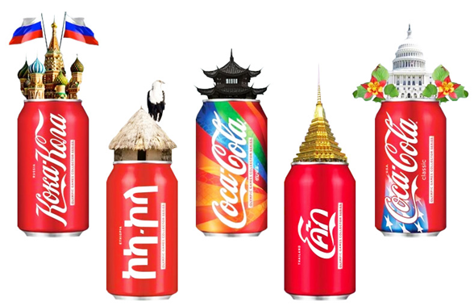
Spread of Globalization
The spread of businesses (often American ones) around the world is a symptom of globalization; with it go common business practices and values.
Uniforms and store architecture are standardized worldwide.
Imported products often push local ones out of the market.
The result is the growth of what some have called the Coca-Cola culture – a standardized culture based on the consumption of non-essential goods.

Slide 13
Pros & Cons
Pros:
Jobs it creation
New businesses it opens.
The resources of large companies make it possible to operate where local business people could not afford the start up costs.
Cons:
It stops local business development because small operators cannot compete with large, well-financed, multinational companies.
A share of profits always flows back to the multinational's home country, instead of benefiting the economy where the business is located.

Slide 14
Assignment: Lab 113 on Wednesday & Thursday
Part 1: "Top Ten Global Problems“
Part 2: Global Interdependence

