Slide 1
Conflict in the 21st century
Part 2
Palestine – Israel History
(Beginnings to the Holocaust)

Slide 2
Palestine/Israel
The area of Palestine (Israel) is one of the most important regions in the world.
It is home to several ancient civilizations.
It is on an important trade route.
Produces 1/6 of the world’s oil.
Birthplace of 3 major religions:
Judaism
Christianity
Islam

Slide 3
The “Holy Land”
At the center of the land in question is an area called by many, “The Holy Land”.
It is sacred to all 3 religions.
Jerusalem is at the centre.

Slide 4
Conflict
Conflicts, between the Israelites (Hebrews, Jews) and Philistines (Arabs), are depicted in the ancient scriptures and texts (The Old Testament - David and Goliath).
Moses led the Hebrews (Jews) out of Egypt (Arabs) during the Exodus.
The Israelites and the Arabs lived in the land of Israel/Palestine through ancient times right up until around 70CE.

Slide 5
What happened in the year 70 CE?
Many empires were created within this region before the common era (Babylonians, Persians).
In 70 CE, “the dispersal” – “the Diaspora”.
The Romans (Emperor Titus), who controlled the region (Middle East), forced the Jews (Hebrews) out of the region. The Jews migrated to different parts of the world. The majority of Jews made their way to Europe where millions would prosper in the arts, the humanities, business and science.

Slide 6
Jewish Persecution
Because of minor differences in beliefs and practices, the Jews living in Europe were subjected to terrible acts of persecution.
For example, in the 1300’s the Church in Europe imposed its rule of law through the “Inquisition.” Many Jews would be executed after having been branded heretics (non-believers).

Slide 7
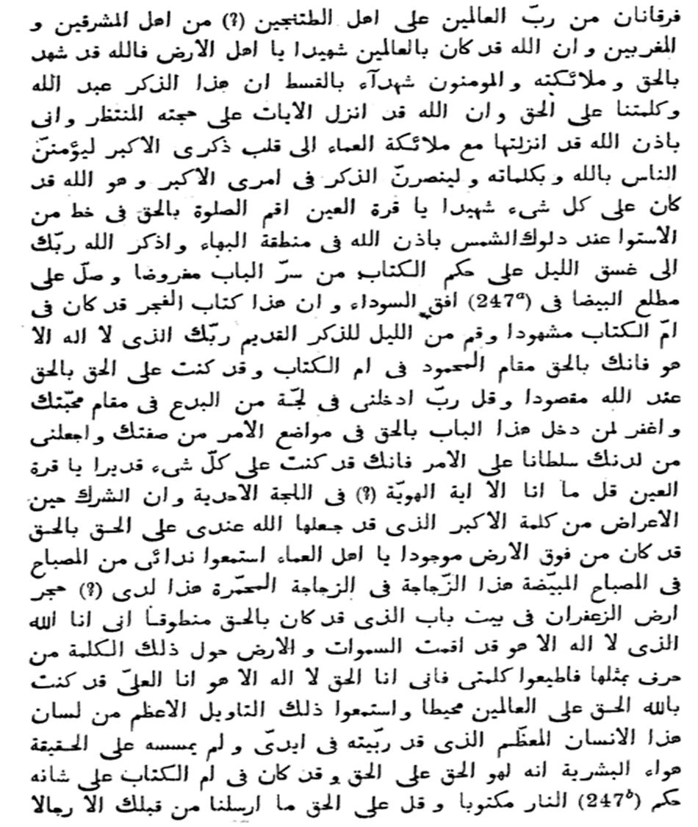
The Rise of Islam
Meanwhile, the Arabs controlled the entire region of the Middle East.
The Arabs living in Palestine/Israel at this time were referred to as Palestinians.
They adopted the religion Islam in mid-500 CE (created by the prophet Mohammed).

Slide 8
Because of a dispute over who would follow as caliph, or leader, Islam experienced a schism, or division into two rival groups:
The Sunni believe that the first four caliphs--Mohammed's successors--rightfully took his place as the leaders of Muslims. They recognize the heirs of the four caliphs as legitimate religious leaders. These heirs ruled continuously in the Arab world until the break-up of the Ottoman Empire following the end of the First World War.
The Shia – believe that
only the heirs of the fourth caliph, Ali, are the legitimate successors of Mohammed.
90 % of the Muslim world

Slide 9
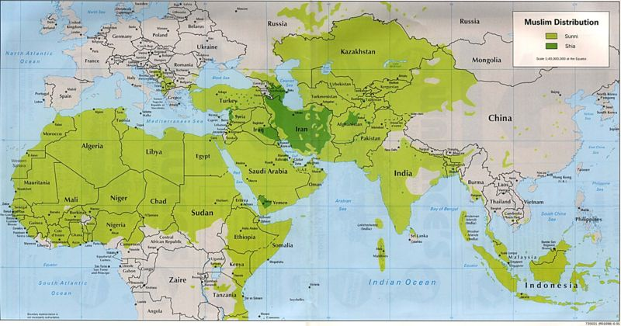
Islam today

Slide 10
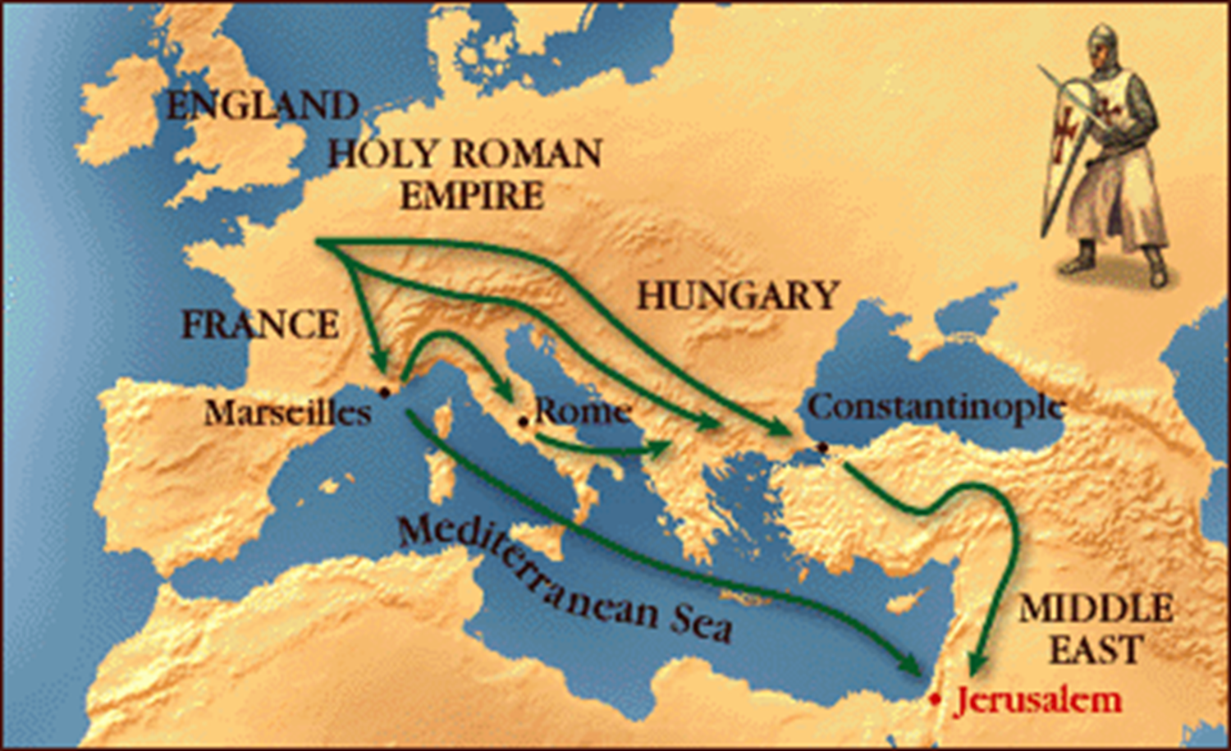
The Crusades

Slide 11
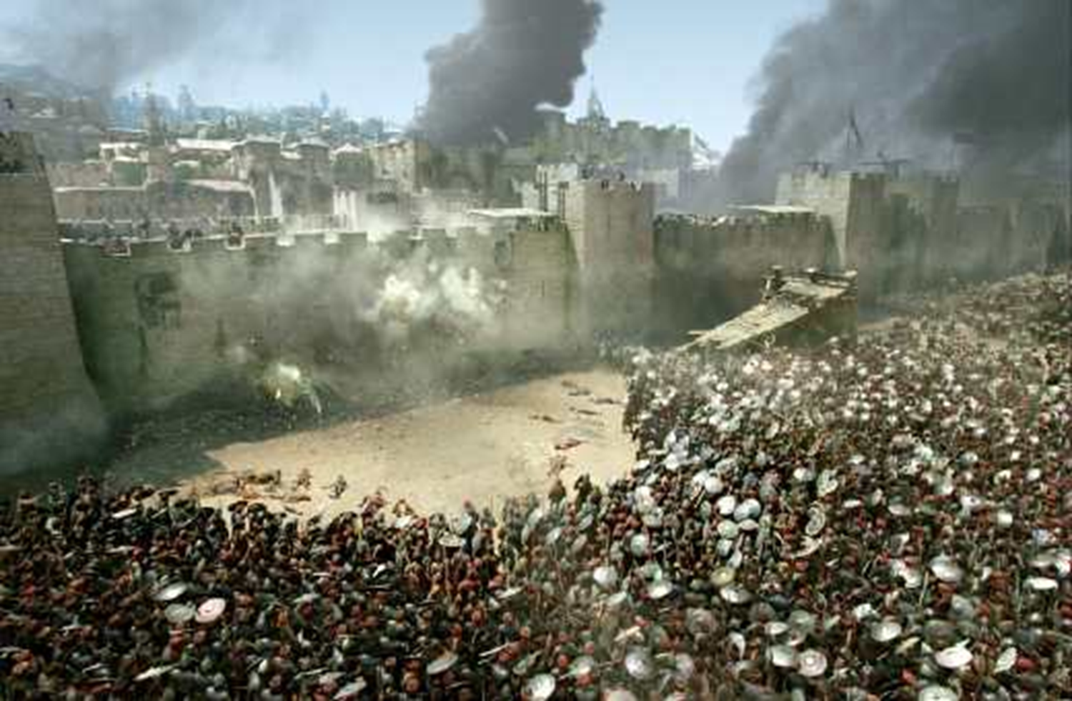
The Holy Land
In 1095, the Middle East, still under control of the Muslims, became the battleground between Christian Crusaders and Muslims.
They were fighting over the Holy Land.

Slide 12
Jerusalem

Slide 13
Fast-forward to World War One
At this time Turkey (‘The Ottoman Empire’), controlled the entire Middle East.
By 1917, Turkey was on the side of Germany, Italy & Austria-Hungary.
This meant that, they were fighting against Britain, France and Russia - the Allies.

Slide 14
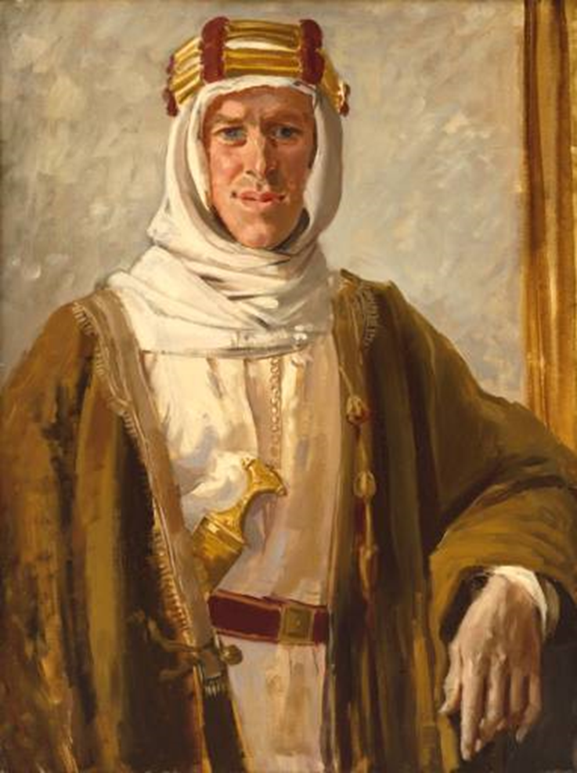
The British sent T.E. Lawrence to assist the Arabs in defeating the Turks in order to gain control over their lands.
The Arabs were happy to help, because they did not like being under foreign rule.
T.E. Lawrence “Lawrence of Arabia”

Slide 15
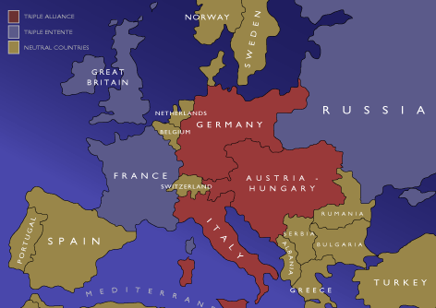

Slide 16
After WWI
The Arabs assumed that their land would be returned to them when the Allies were victorious.
Britain told them no different.
BUT... During WWI (1917), the British released the Balfour Declaration. This document favoured the creation of a state for the Jewish people in Palestine.

Slide 17
When the allies defeated the Turks in World War I (1918), they divided the Middle East up amongst themselves.
The British took control of Palestine, Transjordan, and Iraq.
The French took Lebanon and Syria.

Slide 18
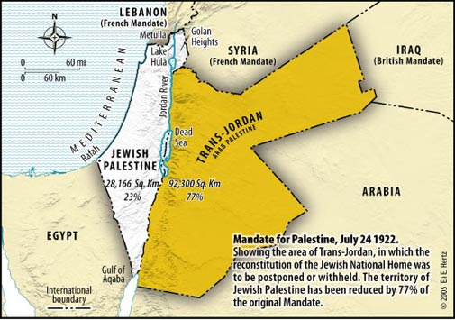
Post WWI
Britain encouraged Jewish immigration to Palestine.
There are several small protests and riots.
All stays relatively quiet until the 1930`s.

Slide 19
World War II and the White Paper
It wasn’t long before another world war was looming. In order to win this war, the British needed the support of the Arabs (oil) so they released the White Paper which favoured the creation of an Arab (Palestinian state) in Palestine. The Jews were furious.

Slide 20
The Holocaust

Slide 21
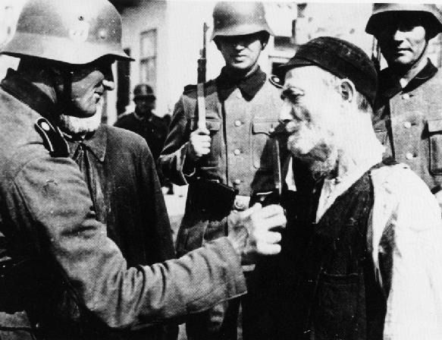

Slide 22
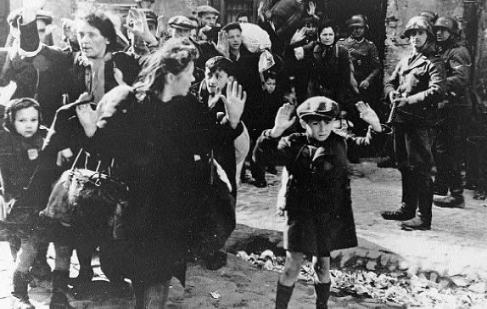

Slide 23
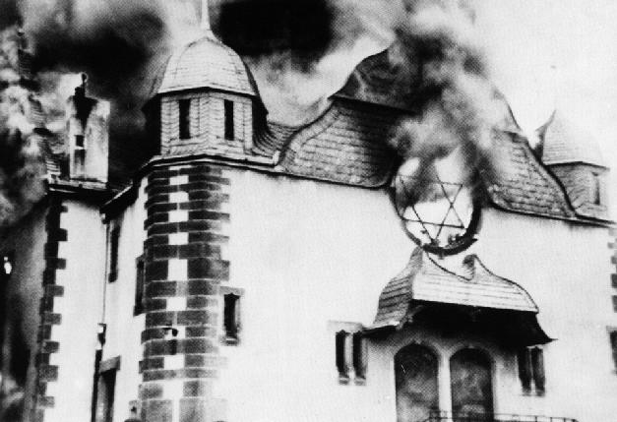

Slide 24
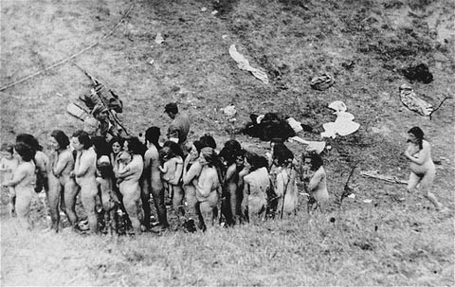

Slide 25
Through the 1930’s and 40’s, the Nazis in Europe persecuted and massacred millions of Jews.
Evidently, the world is sympathetic to the Jewish cause, the creation of a Jewish State in Palestine for the world’s Jews.
After WWII, the British tried to limit Jewish immigration to Palestine. Many Holocaust survivors were liberated from Nazi camps and found themselves in British camps on the island of Cyprus.

