Slide 1
Conflict in the 21st Century
World Issues 120 – Part 3

Slide 2
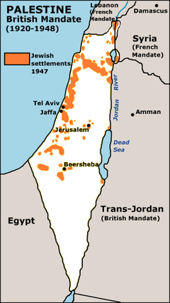
1930`s
Britain proposes a plan to divide Palestine into an Israeli state and an Arab state.
Neither side is happy with this, and violence escalates.

Slide 3
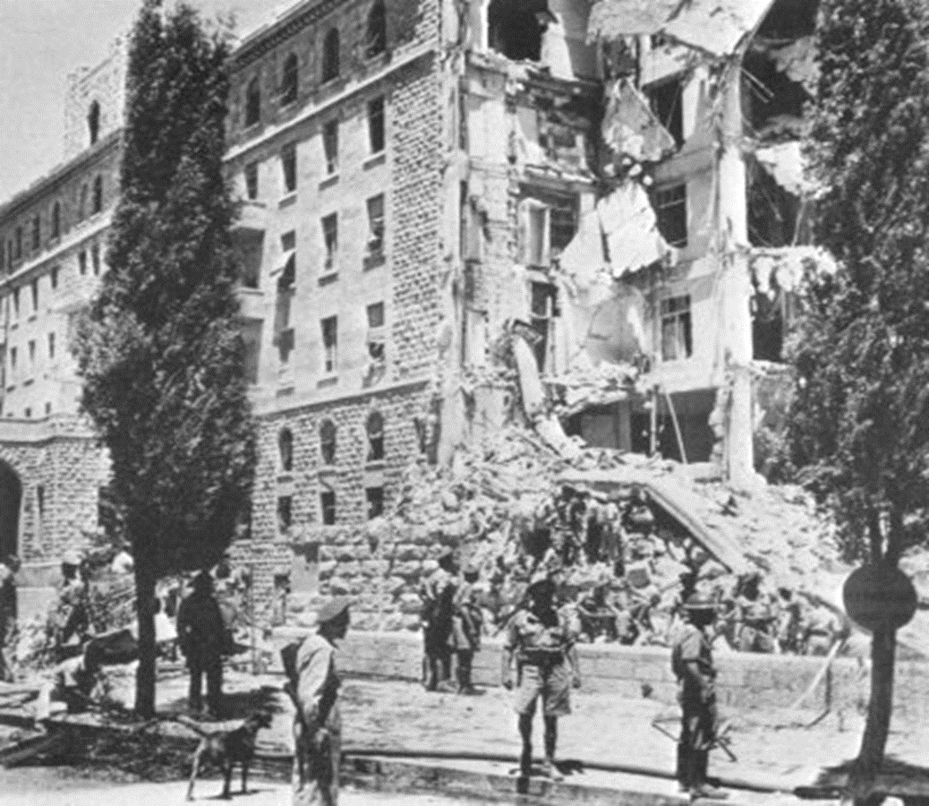
Terrorism
The Israeli (Jewish) and Palestinian situation becomes complex (because of Jewish terrorism (The Stern Gang) and Palestinian terrorism.
In 1946, the Stern Gang blew up the King David Hotel, killing 92 civilians.

Slide 4
The United Nations
Britain is criticized for its policies and places the whole problem in the hands of the U.N.

Slide 5
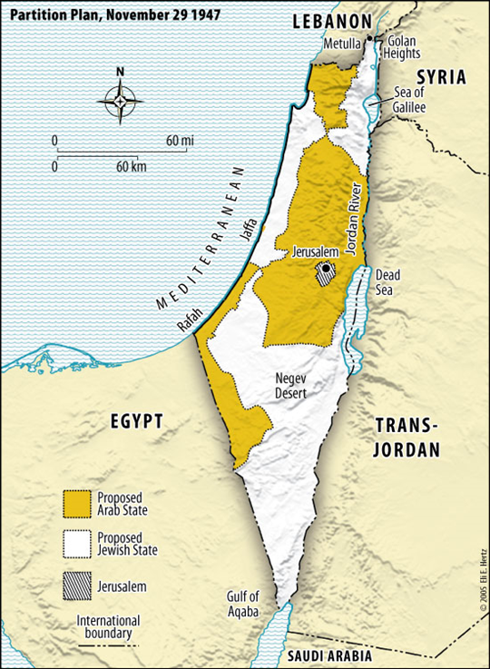
United Nations – Partition Plan 1947
The U.N. implemented a plan to split Palestine (by vote in the General Assembly).
The Jewish part was to be much larger than the Arab part.
The Arab parts were separated from each other.
The Jewish land was more fertile.
Jerusalem would be under the control of the U.N.

Slide 6
1948
As the date for the partition approached, both sides prepared for war, arming themselves.
The Israelis (Jewish) had a strong, well-equipped army.
The Arabs enlisted the help of neighbouring Arab states (Egypt, Syria, Lebanon, Jordan, Iraq)

Slide 7
Liberation or Catastrophe?
The Israelis call 1948 the “Year of Liberation”.
The Arabs call it the “Year of Catastrophe”.

Slide 8
In 1948, with the creation of the State of Israel, a series of conflicts began…
Arabs refused to acknowledge that the country of Israel existed.
Part of the reason that they would not negotiate a peace treaty.
They want to destroy Israel and restore Palestine.
1948 - 5 Arab states attacked Israel.
Israel won.

Slide 9
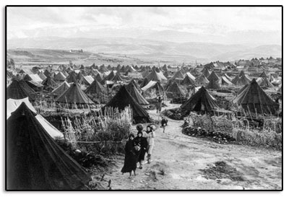
Refugees
Over 1 million Palestinians become refugees.
They flee to neighbouring Arab countries and the Gaza strip (under the control of Egypt), or the West Bank (under the control of Jordan).

Slide 10
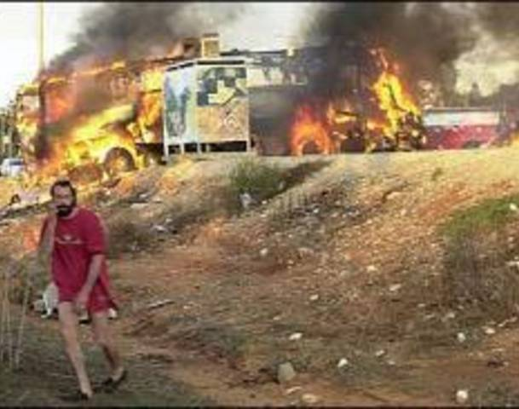
Guerrilla Warfare
Palestinians made raids into Israeli territory.
They lay mines, bomb buses, blow up power stations, etc.
Israel responded by sending the military into the Palestinian refugee camps.

Slide 11
1956 - Suez War - Pres. of Egypt, Gamal Abdul Nasser attempted to take over ownership (nationalize) of the Suez Canal.
Great Britain and France because they built the Canal owned and operated it. Israel is angry because Egypt can now close the Canal to Israeli traffic.
The US brokered an end to the war.

Slide 12
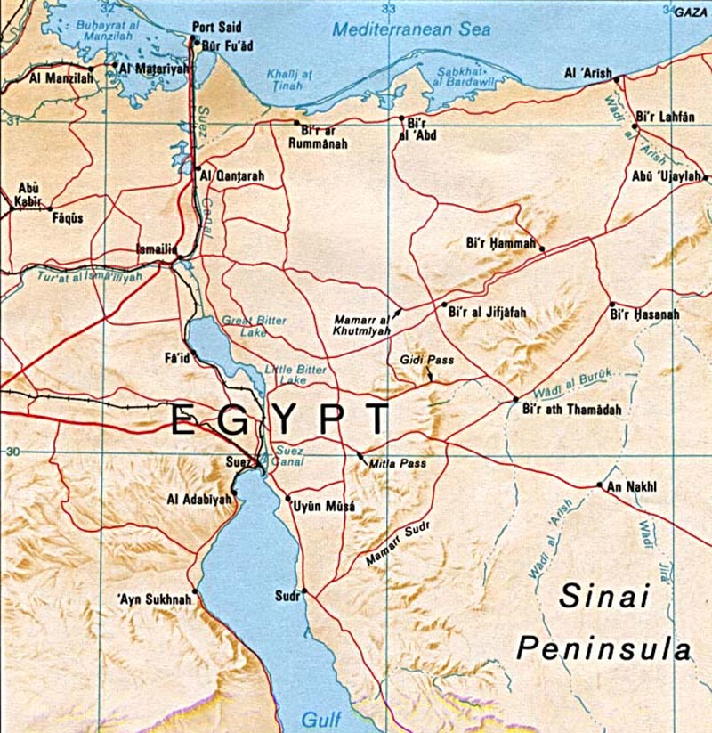

Slide 13
UN Peacekeeping
This crisis threatened to divide the Western military alliance that had won WWII (between US, Great Britain and the other allies).
Working with the UN, Canadian Lester B. Pearson developed the idea for the UN Peacekeeping force.
A cease-fire was arranged and the UN peacekeepers (under the command of a Canadian General) entered the canal area which allowed for the two sides to withdraw their forces without giving the appearance of defeat.

Slide 14
The 6-Day War (1967)
An Israeli tractor was ploughing in disputed territory when it was fired on by Syrian guns.
Israel sent in planes to destroy those guns.
All countries in the area began massing troops and weapons.
Russia was backing the Arab countries and encouraged them to attack and wipe out Israel once and for all.

Slide 15
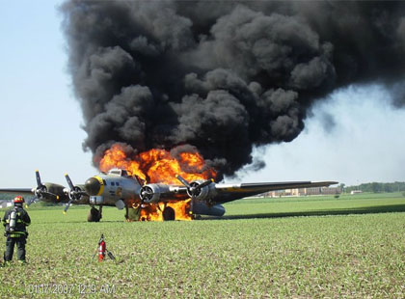
Israel Responds – 6 Day War
Israel decides not to wait to be attacked.
They bomb airfields and destroy air forces
Ground troops then move in and are very successful.

Slide 16
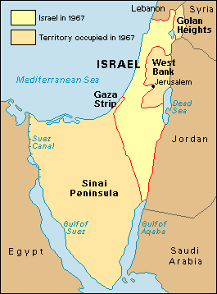
6-Day War
The U.N. orders a cease-fire.
Israel keeps the territory that they conquered (Gaza Strip, Sinai, West Bank, part of Syria)

Slide 17
The PLO
The varied Palestinian resistance groups join together in order to be more effective.
They become known as the Palestine Liberation Organization.

Slide 18
After the 6-Day War
Israel is in total control of the area.
Arabs see the PLO as their only hope – guerrilla warfare increases.

Slide 19
Acts of Terrorism – 1970s
In the 1970’s, the PLO increased its acts of terrorism. It began to hijack and blow up planes and bomb sites to harm those supportive of Israel.
At the1972 Olympics in Munich – Israeli athletes were taken hostage and 11 were executed, two immediately and nine later during a botched escape attempt.

Slide 20
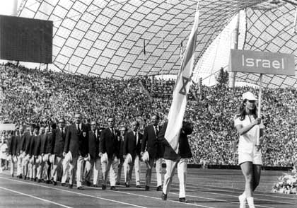

Slide 21
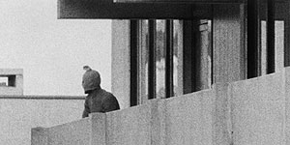

Slide 22
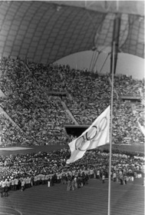

Slide 23
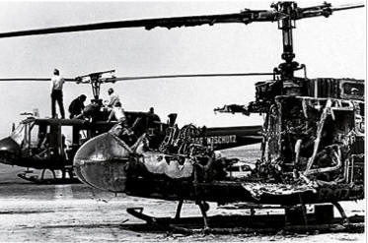

Slide 24
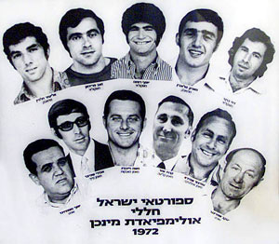

Slide 25
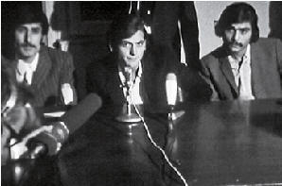

Slide 26
Yom Kippur War/The Ramadan War - 1973
Yom Kippur is a Jewish Holy Day so Egypt, Syria, Iraq and Jordan used that to their advantage and planned a surprise attack on Israel for October 6, 1973. This war lasted until October 25th.
Egypt’s new leader, Anwar Sadat, wanted to reverse the results of the 6-Day War and regain the territory that Egypt lost.
He asks the USSR for more weapons, and makes a deal with Syria that they will attack at the same time.
They crossed the cease-fire lines captured by the Israelis during the 6-Day War.

Slide 27
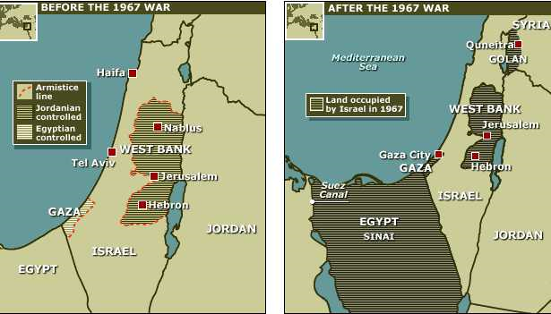

Slide 28
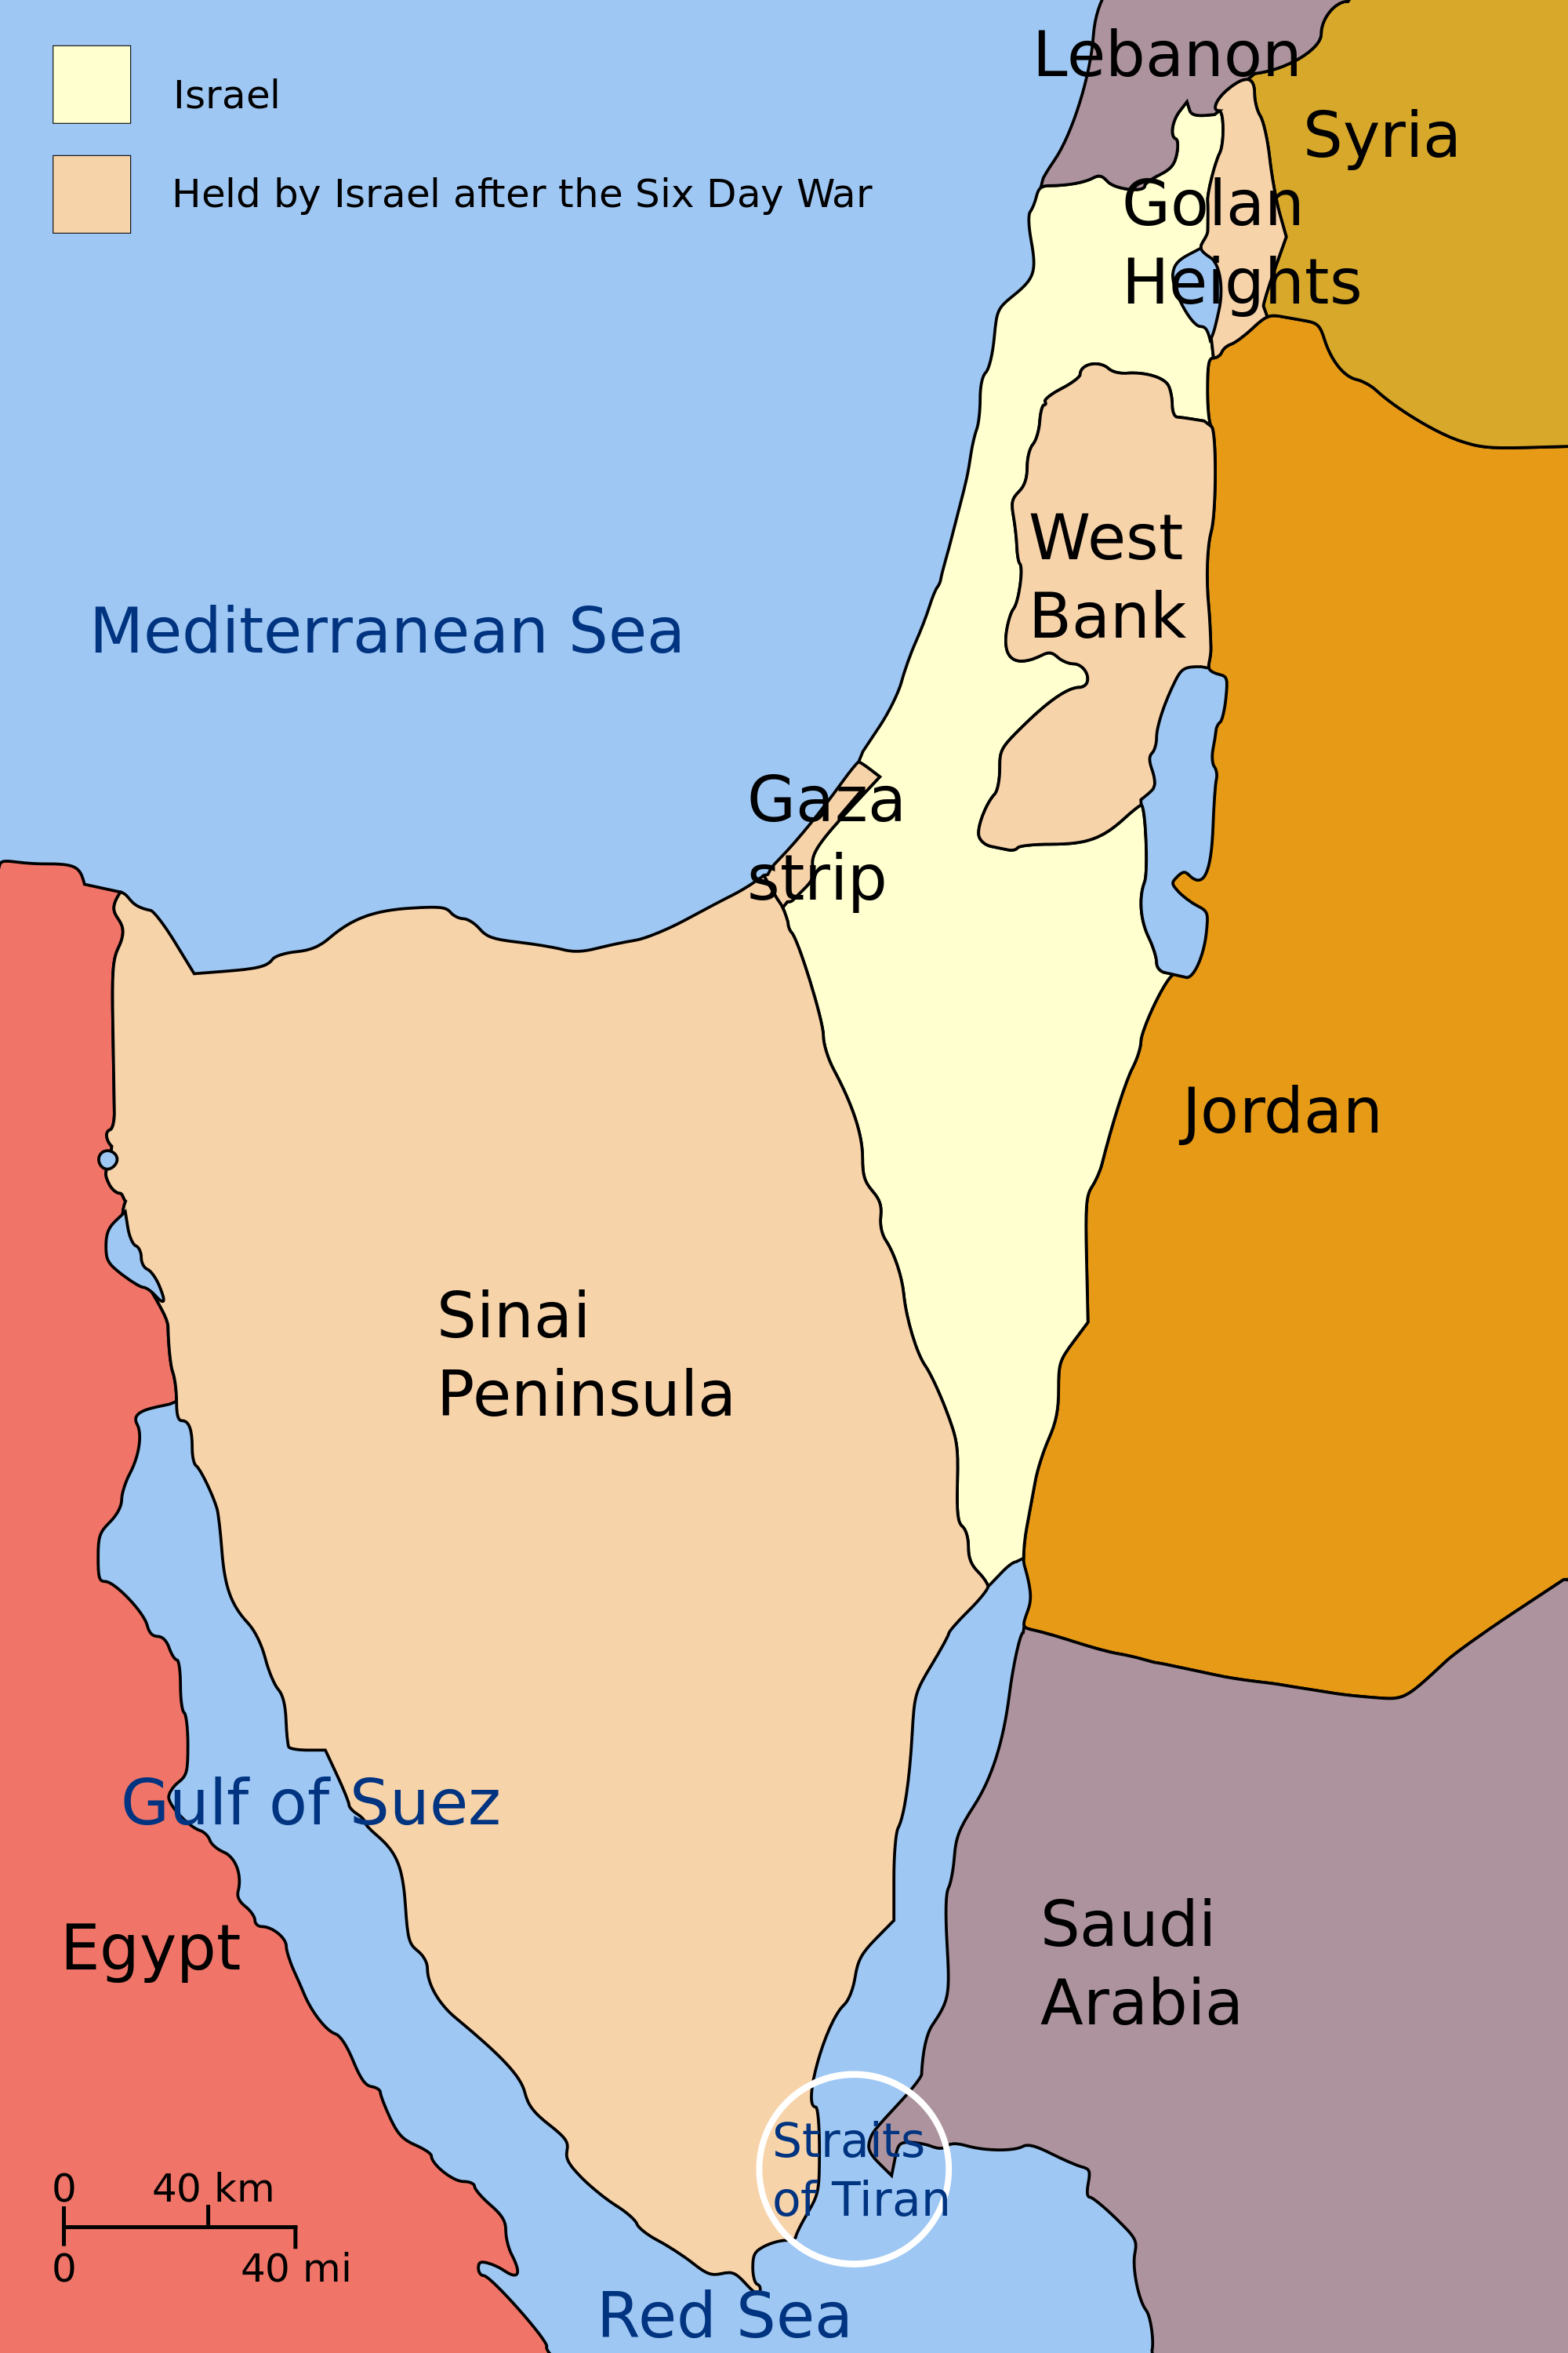

Slide 29
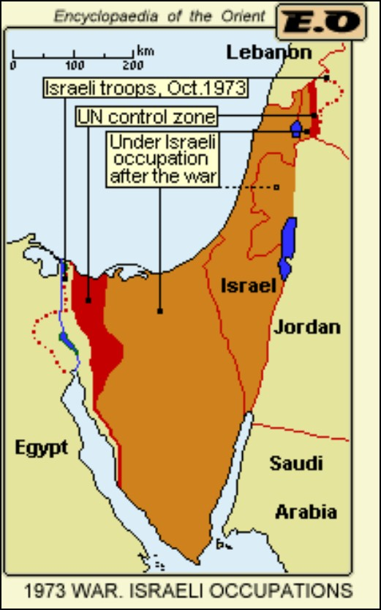
Israel won again… and increased its territory.

Slide 30
Peace with Egypt
1977 – Egypt & Israel signed a peace treaty
It was an attempt at controlling the relations between the two countries and to have a complete withdrawal of the armed forces and civilians of Israel in what once was Egypt.
Terms:
Egypt agreed to leave the area demilitarized
Israel withdraws to previous borders
Allows Arabs some self-government in Gaza Strip & West Bank
Israel allowed to use Suez Canal
The agreement notably made Egypt the first Arab state to officially recognize Israel. (This was seen as a stab in the back by other Arab states.)

Slide 31
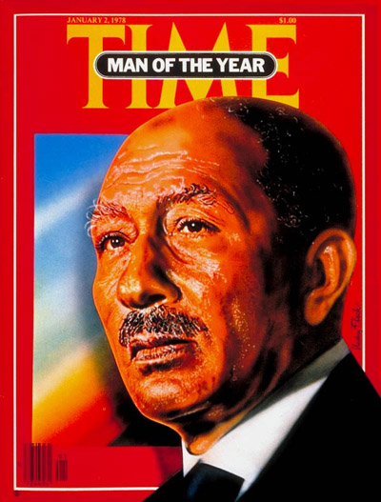
PLO reacts
The PLO was furious about the peace treaty.
President Sadat of Egypt was assassinated.

Slide 32
Lebanon Invasion
1982 – Israel bombed Southern Lebanon (to attack PLO bases).
Commander Ariel Sharon directed attacks on the Shatila and Sabra refugee camps.
Many civilians, including children were killed.

Slide 33
Occupied Territories
In the occupied territories, the Palestinian people were dealing with isolation, some say persecution, and a lack of civil rights.
As a result of the conditions within the occupied territories, more terrorist organizations have evolved.

Slide 34
Security Barrier
Suicide bombers (Hamas, Islamic Jihad, Al Aqsa Brigades, PLO) and severe retaliations (Israel) through the 90’s until present have increased the complexity of the conflict.
From 1993–2003, 303 Palestinian suicide bombers attacked Israel.
Israel’s response to the suicide attacks has been the construction of a “security barrier”.

Slide 35
The plan was to have the barrier eventually run around the Palestinian areas making it incredibly hard for them to leave (or attack).
One last section of the barrier remains to be completed but the Israeli/Palestinian governments voted to not continue the barrier in 2014.

Slide 36
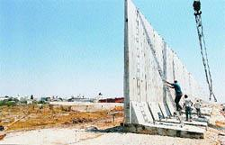
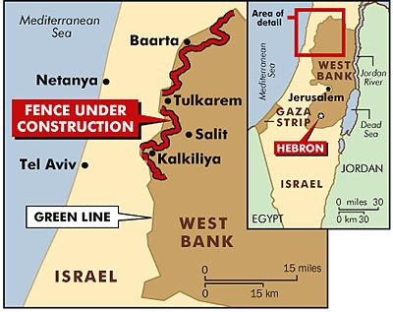
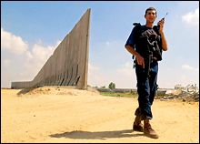
The Security Barrier

Slide 37
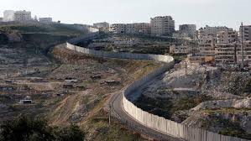
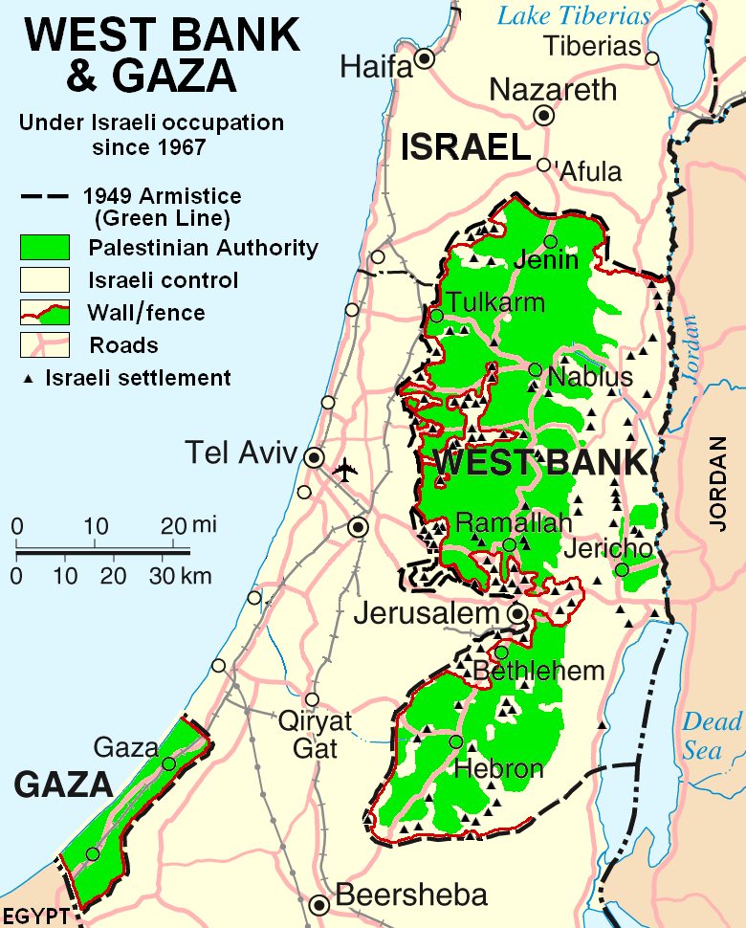
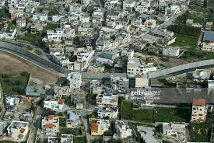

Slide 38
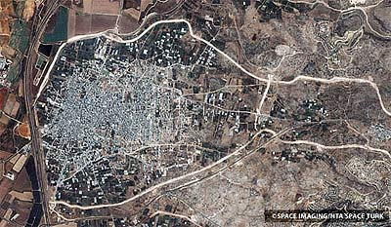

Slide 39
Results
Suicide bombings into Israel by Palestinians have decreased since the construction of the barrier.
The barrier has had many effects on Palestinians including:
reduced freedoms
reduction of the number of Israel Defense Forces checkpoints and road closures
loss of land
increased difficulty in accessing medical and educational services in Israel
restricted access to water sources
economic effects.

Slide 40
Peace Activists
There are many peace activist on both the Palestinian and the Israeli sides.
Thousands of people from around the world are discussing ways to bring peace to the region.

Slide 41
Rachel Corrie (April 10, 1979-March 16, 2003)
An American activist who had gone to Gaza as part of her Senior-year in college.
Member of the pro-Palestinian group called the International Solidarity Movement.
Killed by an Israel Defense Forces armored bulldozer in a combat zone – they were carrying out demolitions on houses (the procedure to discover explosive devices and destroy tunnels used by terrorists to smuggle weapons from Egypt to Gaza).

Slide 42
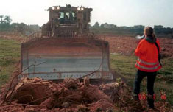

Slide 43
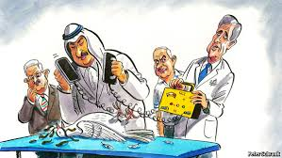
Peace? Government Approaches
Many attempts have been made to negotiate a peace settlement and create a two-state solution.
Ideally, they would be attempting to create an independent Palestinian state alongside the established State of Israel (as it was created in 1948).

Slide 44
In the late 1970’s, President Jimmy Carter sponsored a peace agreement between Israel’s Prime Minister Menachem Begin and Egypt’s President Anwar Sadat.
The leaders each received the Nobel Peace Prize for their efforts.
In 1981, Anwar Sadat was assassinated by one of his own troops.

Slide 45
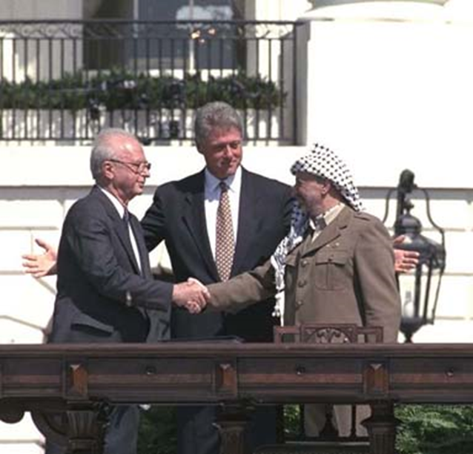
Oslo Peace Accord
In 1993, Israeli Prime Minister Yitzak Rabin and Palestinian leader Yasser Arafat signed The Oslo Peace Accord. President Bill Clinton hosted the leaders at the White House.
The Accord gave the Palestinians a larger degree of autonomy over the West Bank (i.e. Ramallah).

Slide 46
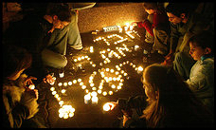
Both leaders, Rabin and Arafat, received the Nobel Peace Prize.
A few years later, after leaving the stage at a rally for peace, Rabin was shot in the back of the head by one of his own citizens.

Slide 47
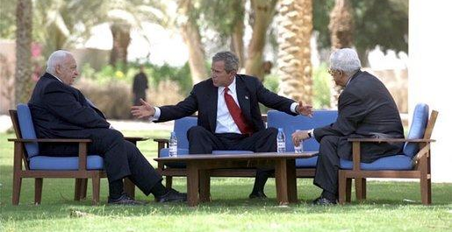
Roadmap for Peace - 2003
President George W. Bush issued his Roadmap for Peace. It was met with mixed results. The process reached a deadlock early in phase I and the plan was never implemented.
Of course, the events in Iraq took the focus off of the efforts to implement this document.

Slide 48
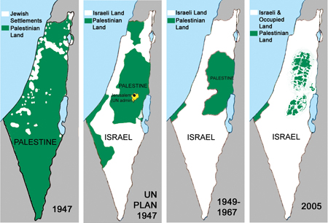

Slide 49
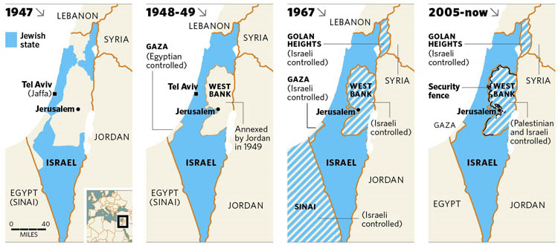

Slide 50
Now?
The latest round of peace negotiations began in July 2013 and was postponed in 2014.
The official negotiations are mediated by an international contingent known as the Quartet on the Middle East that consists of the United States, Russia, the European Union, and the United Nations.
The Arab League is another important actor, which has proposed an alternative peace plan. Egypt, a founding member of the Arab League, has historically been a key participant.

Slide 51
Current Leaders
Israeli Prime Minister: Benjamin Netanyahu
President of the State of Palestine:
Mahmoud Abbas

Slide 52
Palestinian Government
Since 2006, the Palestinian side has been fractured by conflict between the two major factions:
Fataḥ: formerly the Palestinian National Liberation Movement - a secular Palestinian political party and the largest faction of the confederated multi-party Palestine Liberation Organization (PLO).
Hamas: Islamic Resistance Movement - a Palestinian Sunni-Islamic fundamentalist organization. Since 2007, has been the governing authority of the Gaza Strip.
In 2014, a Palestinian Unity Government, composed of both Fatah and Hamas, was formed.

Slide 53
The State of Palestine
A partially recognized state in the Middle East.
Its independence was declared on 15 November 1988 by the Palestine Liberation Organization (PLO).
The State of Palestine claims the West Bank and Gaza Strip, with East Jerusalem as the designated capital.
The Palestinian Authority applied for United Nations (UN) membership in 2011 and in 2012 was granted a non-member observer state status – which amounts to, for all intents and purposes, it being a recognized as a state.

Slide 54
Gaza
Israeli security measures and Israeli-Palestinian violence continue to degrade economic conditions in the Gaza Strip
Israeli-imposed border controls became more restrictive after HAMAS seized control of the territory in June 2007.
Egypt’s ongoing crackdown on the Gaza Strip’s extensive tunnel-based smuggling network has exacerbated fuel, construction material, and consumer goods shortages in the territory.
Israel removed settlers and military personnel from Gaza Strip in August 2005

Slide 55
Main issues regarding the Gaza residents:
Desertification
Build up of salt in their fresh water
sewage treatment
water-borne disease
soil degradation
depletion and contamination of underground water resources
high unemployment
elevated poverty rates

Slide 57
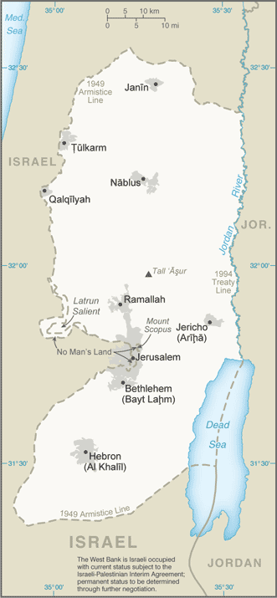
West Bank
The West Bank was under Israeli military control until Israel transferred security and civilian responsibility for many Palestinian-populated areas of the West Bank and Gaza Strip to the Palestinian Authority under a series of agreements signed between 1994 and 1999.

Slide 58
Israeli settlements
In the years following the Six-Day War, and especially in the 1990s during the peace process, Israel re-established communities destroyed in 1929 and 1948 as well as established numerous new settlements in the West Bank.
These settlements are, as of 2009, home to about 301,000 people and have been the site of much inter-communal conflict.
The United Nations and the European Union have also called the settlements illegal under international law.

Slide 59
Conflict continues…
Palestinians feel that the settlements divert resources needed like fertile land and water. The settlements also reduce their ability to travel freely via local roads because of the security.
Israelis feel that they need to retain some of the West Bank land and settlements act as a buffer in case of future aggression. They also feel that some of the settlements are legitimate, as they began before there was any agreement between the conflicting sides. (They did not violate any agreement.)

Slide 61
A Case Study - Your Assignment
Pair up and research one modern-day conflict – see list.
The goal is to explore:
CAUSES (combination of reasons?)
Threats each party felt
Geographic situation & lead-up to the conflict
Impact on people/citizens
Efforts to resolve it/how it was resolved
You will prepare a PowerPoint presentation and explain the conflict to the class.

