Slide 1
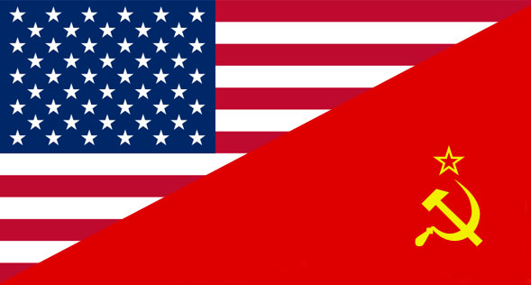
Cold War
USA vs USSR
1945-1991

Slide 2
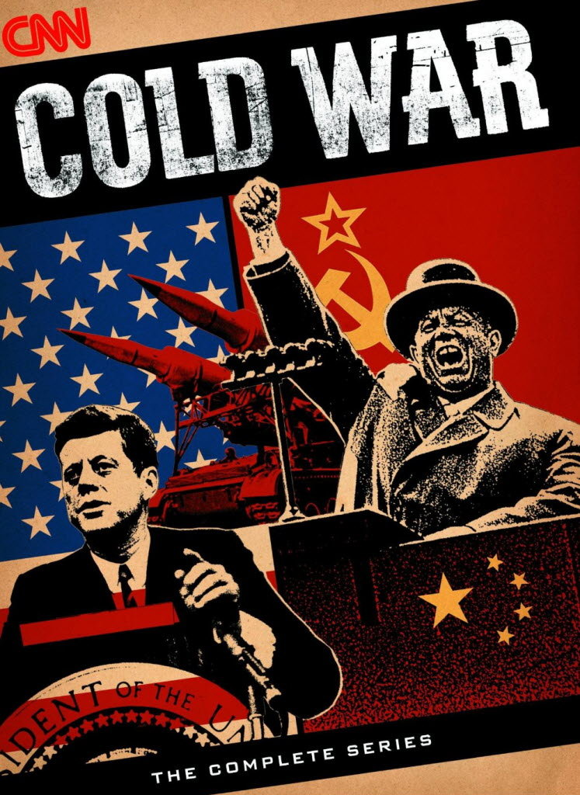
War of Ideology
Communism vs. Capitalism
Democracy vs. Dictatorship
Freedom vs. Tyranny
The Cold War was "cold" because there was not a real war or battles directly against the other.
It was a war of words and threats (there were a few small localized battles.)

Slide 3
It all started at the end of the World War 2
The USSR and the Allies cooperated to win the war against the Nazis.
Now, they could divide the territory of Germany.

Slide 4
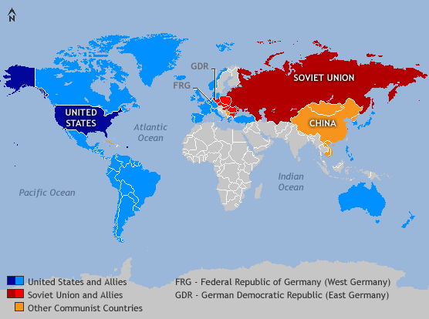
There were 2 main groups:
USA
Canada
Britain
Western Europe
USSR
Cuba
China
Eastern Europe
vs.

Slide 5
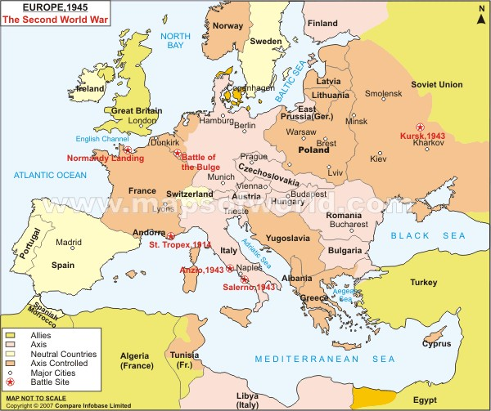
Europe during the 2nd World War

Slide 6
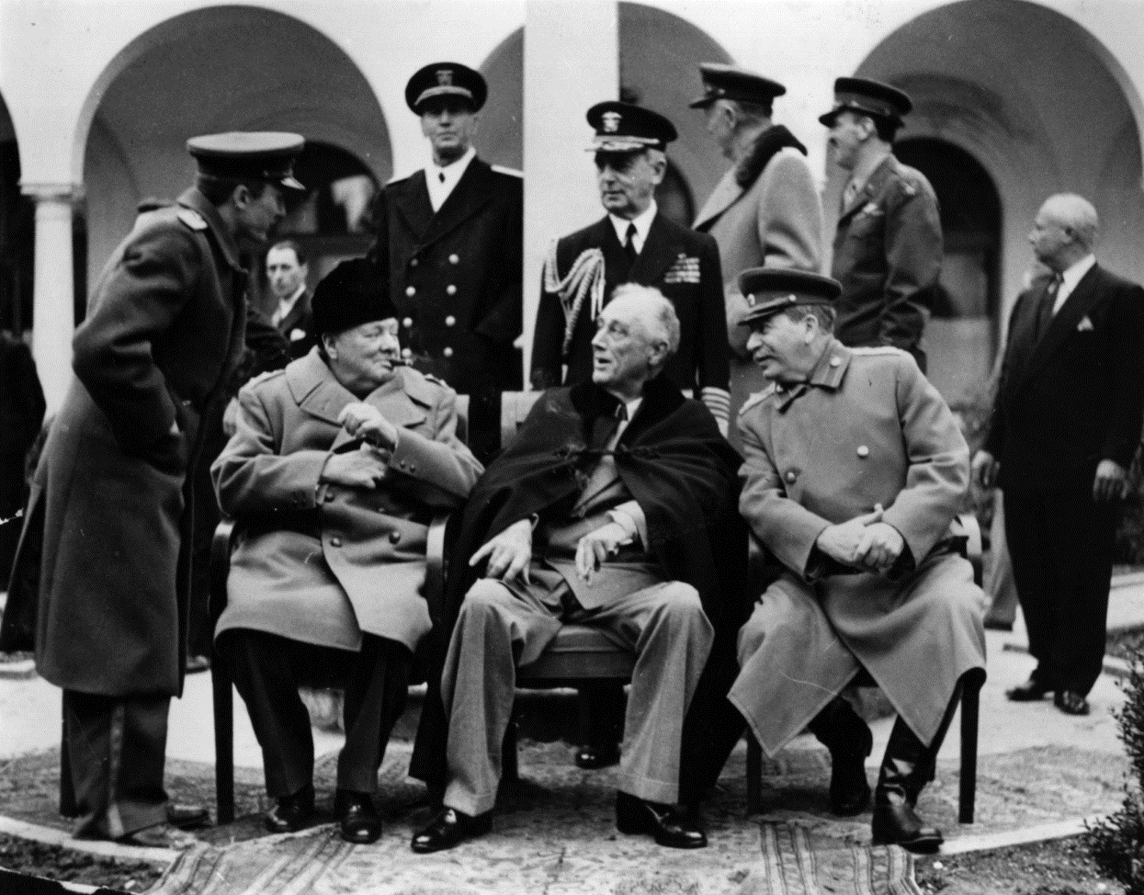
The Yalta Conference – Feb. 1945
Big Three: Churchill, Roosevelt & Stalin
Met and made important decisions regarding the future progress of the war and the postwar world.
Notes:
Meeting post WWII to divide up Europe.
USSR and GB had already secretly agreed on most of the divisions – ex Brits got 90% of Greece USSR -- 90% of Romania
US didn’t want USSR to gain control of all of Eastern Europe.

Slide 7
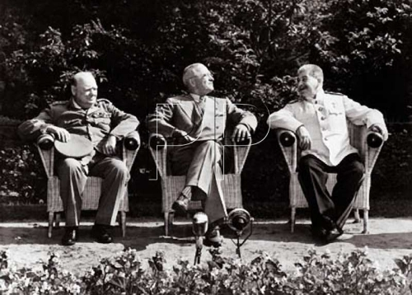
Potsdam Conference – July 1945
Churchill Truman Stalin
Met to negotiate the terms for the end of World War II
Notes:
Churchill was soon to be replaced by PM Atlee
Truman just replaced Roosevelt (who passed away) and was much tougher on Stalin.

Slide 8
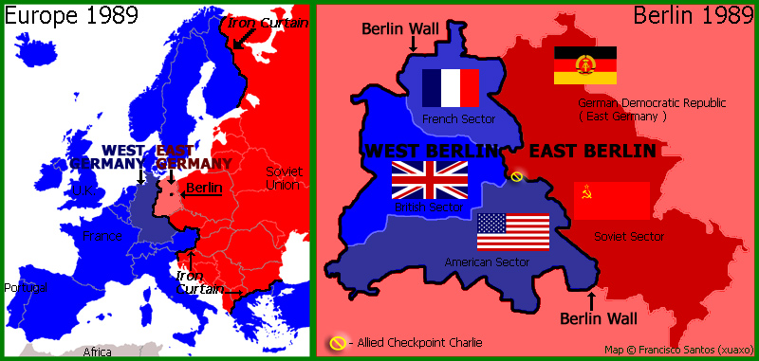
Division of Germany

Slide 9
The causes of the Cold War
Ideology
The actions of the Soviet Union
Arms race: the development of nuclear weapons

Slide 10
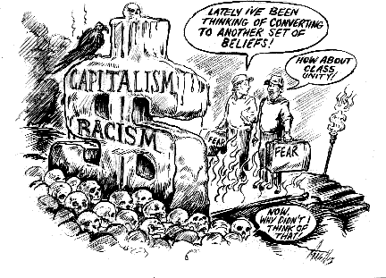
1. Ideology means different values ​​and ideas about political and economic systems.
Each side believed that their ideology was the best and had to be spread around the world. They also believed that they had to avoid another ideology.

Slide 11
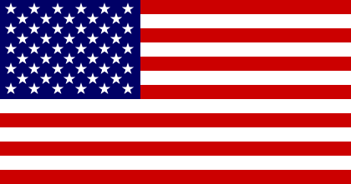
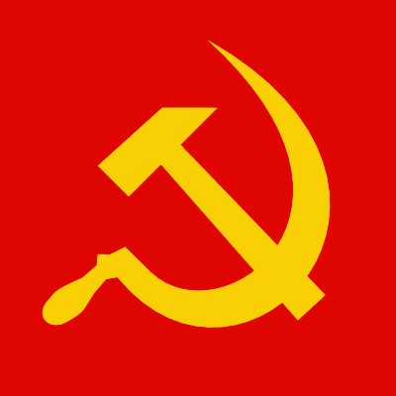
Political Systems
United States
Soviet Union
Democratic
Free and fair
Individual freedoms - if you work hard, you will have $$
Totalitarian
Control of one political party
The individual works for the benefit of everyone. No rich and poor

Slide 12
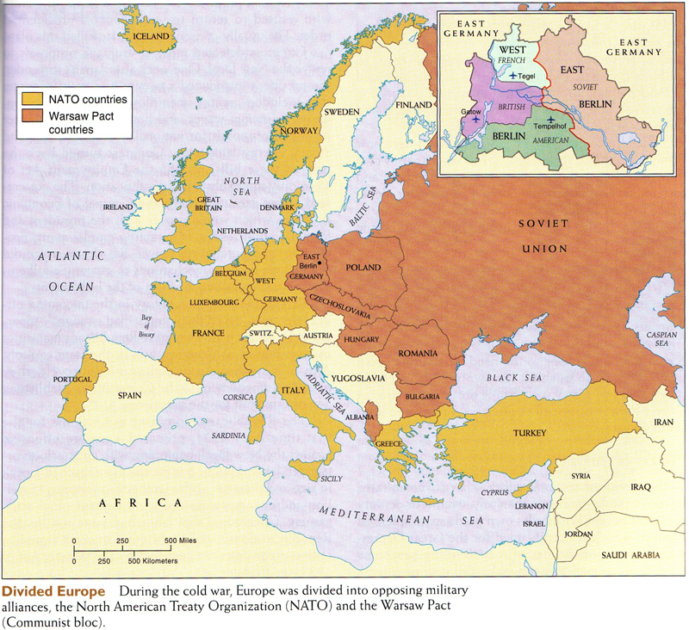

Slide 13
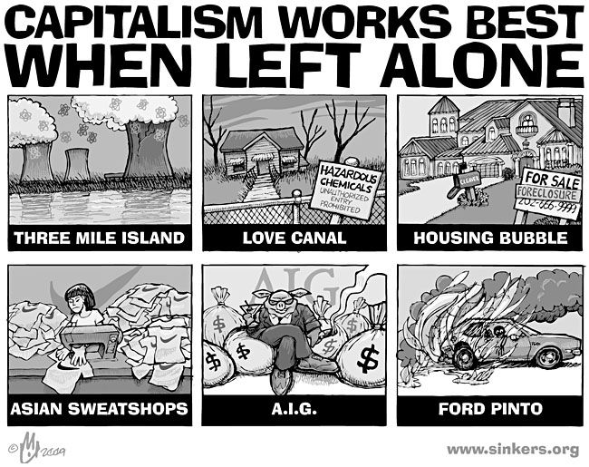
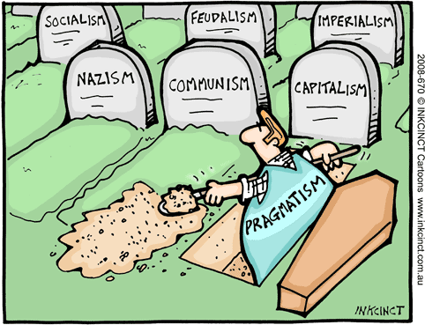
Economic Systems
United States
Soviet Union
Capitalist
Private Ownership in business and industry
Communist
Businesses owned or control by the state

Slide 14
2. The actions of the Soviet Union
After the Second War, the troops of the Soviet Union remained in the countries they had released and tried to strengthen communist governments in some countries of Eastern Europe.

Slide 15
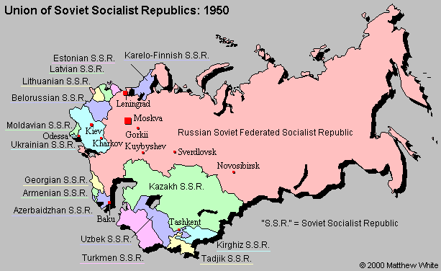
The other European countries under the influence of the Soviet Union were:
Albania Poland Bulgaria Hungary
Romania Estonia Latvia Lithuania
Czechoslovakia

Slide 16
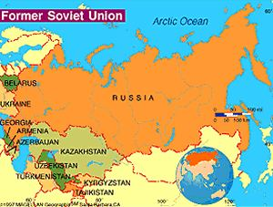
The United States and allies disapproved of these actions. But they have done nothing.
The Soviet Union wanted a zone between
itself and the West.

Slide 17
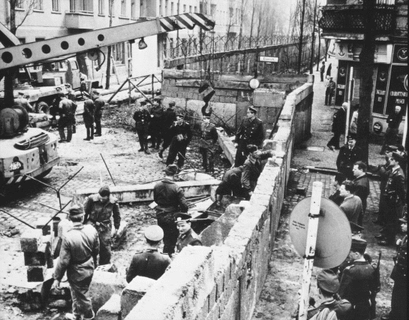
Berlin Wall Construction 1959
http://www.history.com/news/ask-history/how-long-was-the-berlin-wall
https://www.youtube.com/watch?v=ZgiQkM-GBMI

Slide 18
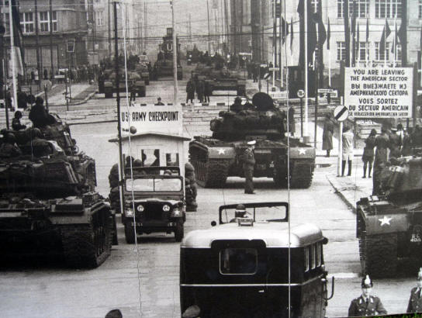
Checkpoint Charlie crossing point between East Berlin and West Berlin
Notes:
Most famous passage through the Berlin Wall

Slide 19
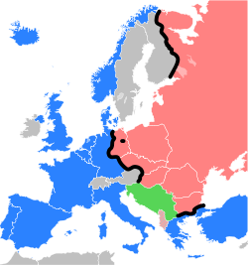
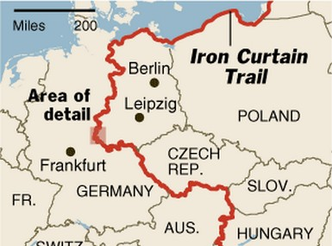
The term "Iron Curtain" began to be used to describe the boundary between Communist and
non-Communist countries in Europe.

Slide 20
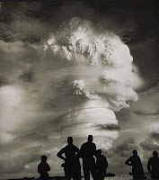
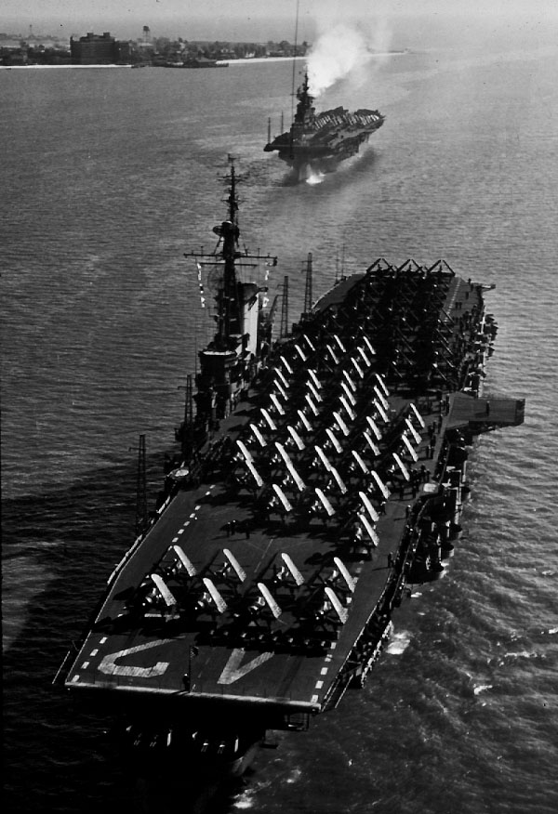
3. The Arms Race
Both sides tried to protect themselves from an attack each other in creating the most sophisticated weapons and defense systems. (Nuclear Weapons) This created fear and suspicion.
https://www.youtube.com/watch?v=5YDYfByEPAY#t=51

Slide 21
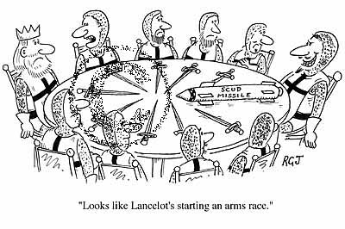

Slide 22
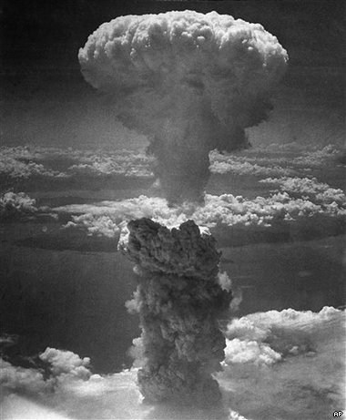
US bombed Hiroshima & Nagasaki, Japan - August 1945 - considered the end of WWII but foreshadowed what was to come.

Slide 23
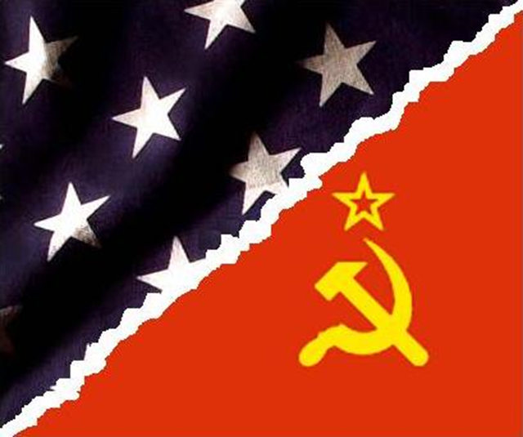
Effects
Introduced the most destructive form of warfare and ended war with Japan
US proved that it had dominant military capabilities.
the USSR and the US could drop the pretence of getting along. The Cold War began.

Slide 24
Upping the anti
Policy of deterrence:
Stronger military and better weapons to ensure that the other side doesn’t attack
1949 – creation of NATO (North Atlantic Treaty Organization (12 countries)
1949 – Soviets exploded their first nuclear bomb

Slide 25
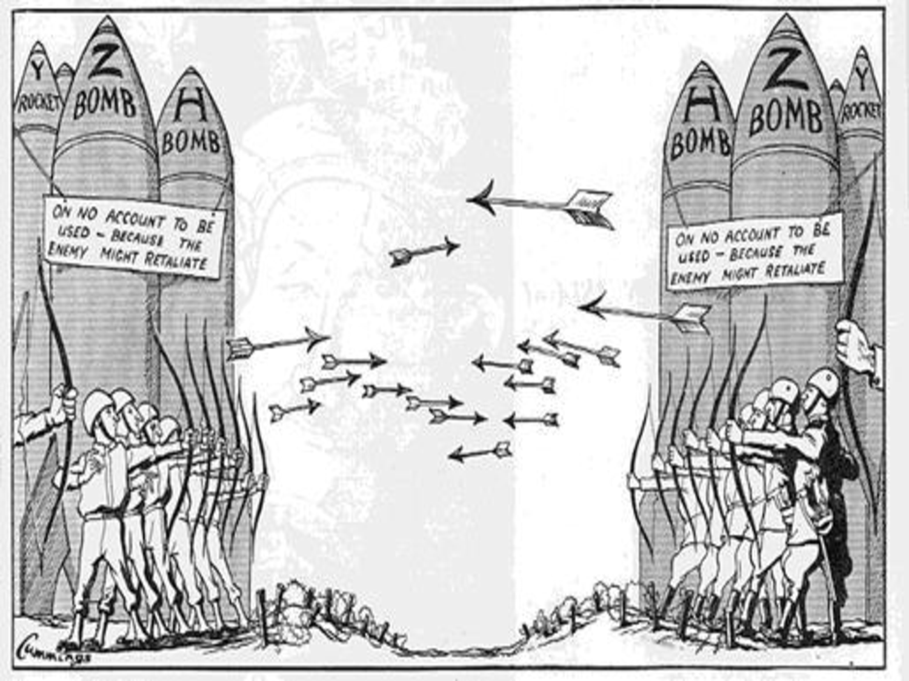

Slide 26
