Slide 1
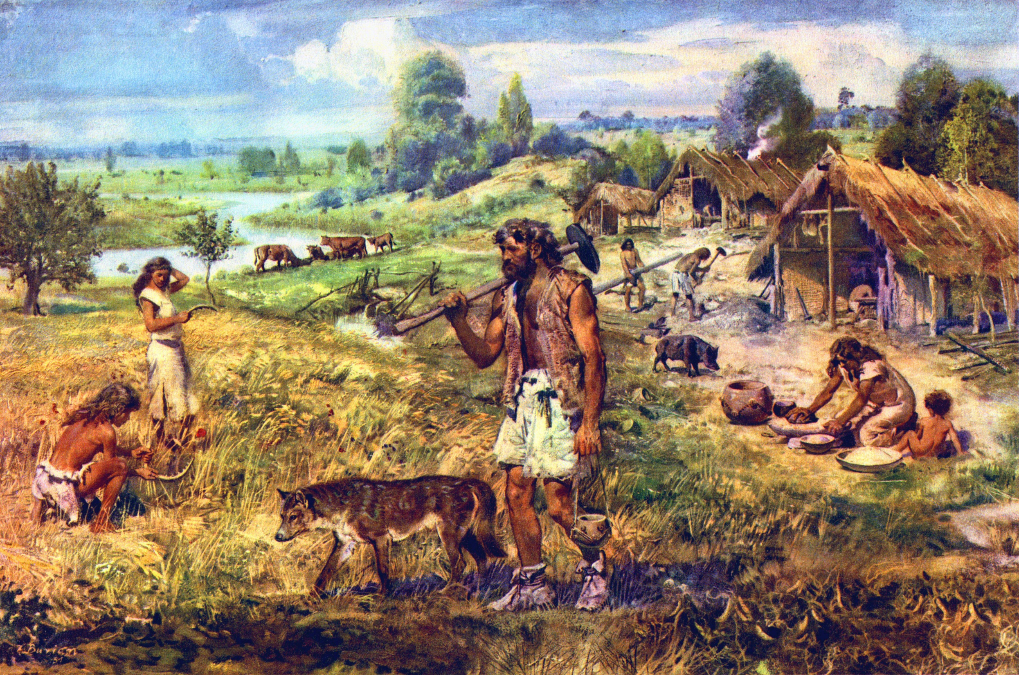
The Agricultural Revolution
aka Neolithic Revolution

Slide 2
There was a period of time in prehistory which would change mans way of life forever. It was a time when man stopped following animals in order to get food and they started living a sedentary lifestyle.
This was known as the Agricultural Revolution!

Slide 3
Two important terms to know
Nomad: a lifestyle where people, hunter gathers, must keep moving in order to find food.
Sedentary: a lifestyle where people build permanent houses, start to domesticate animals and grow their own food.

Slide 4
Brainstorm
What kind of things have to happen when people start to live in larger numbers in one area? Going from nomadic to sedentary lifestyle.

Slide 6
Effects of the Agricultural Revolution
An increase in storable food supply due to invention of farming. (grains most important)
Permanent villages developed
Time not spent looking for food was used to develop skills like making tools, weapons, pottery, baskets, jewelry and clothing.

Slide 7
Effects of the Agricultural Revolution
Craftspeople began to trade with other villages.
Trade led to the development of transportation.
Government and religion developed as leaders emerged in villages.

Slide 8
The development of 2 very important concepts came from the Agricultural Revolution…
Community living
and…..
CIVILIZATIONS!

Slide 9
Brainstorm: What characteristics does a “civilized” community have?

Slide 10
Text book work (15 minutes)
Answer in your notebook: You may work with a partner
Question: 1, 2, 3. page 29.

Slide 11
The Great Leap Forward Cause and Effect of people living is settled communities
Lived in groups effect:
Worked together, shared jobs
Better hunting results, more food
Longer lives, population increase
Safer, protected one another
Hunting
From scavengers to hunter gatherers to food producers
Advanced up the food chain
Safer, healthier food
Lived longer, Population growth
Speech
Development of culture
Ideas, laws, religion
Communicated ideas, shared knowledge
Tool Making
Weapons for hunting
Tools for building and cooking
Better able to gather food at a quicker rate
Built more tools and shelters
Fire
Heat – Shelter – Light
Cooked food
Fewer illnesses
Population growth
Ward off predators

Slide 12
Crash Course in World History #1
https://www.youtube.com/watch?v=Yocja_N5s1I

Slide 13
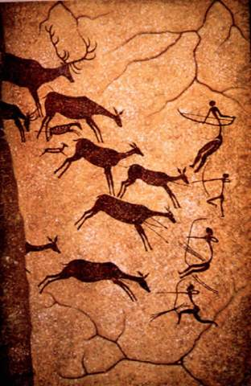
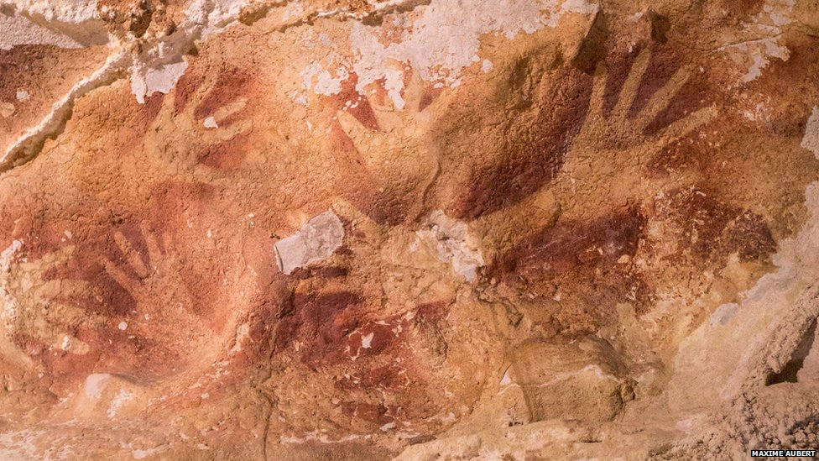
Cave Drawings
Early artists made them by carefully blowing paint around hands that were pressed tightly against the cave walls and ceilings. The oldest is at least 40,000 years old.
Cave painting found in Lascaux, France - Some of these paintings are believed to been made more than 16,000 years ago
https://www.youtube.com/watch?v=nNy85LWLI4Q
http://www.bbc.com/news/science-environment-29415716

Slide 14
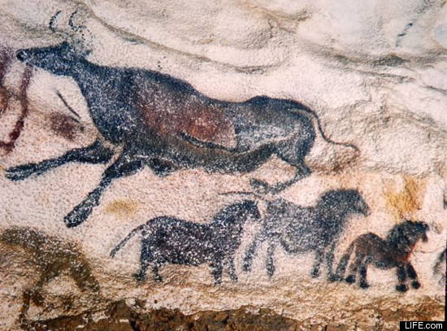
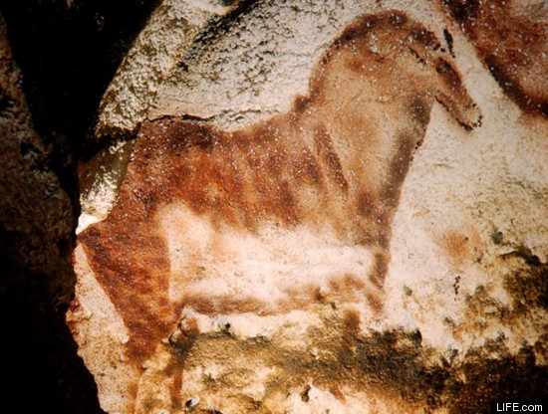
Colors:
reds and yellows - from ground, colored earth
dark shading: charred bone and soot
green was made from manganese oxide
Some of the paintings of animals are 10 or 15 feet in size.

Slide 15
Video-Man Kind the Story of All of Us (2nd half of Video)

Slide 16
Skill Development
Creating Focus questions. Page 32 – 33
Working in a group of 2 or 3
Create a chart similar to the one on page 32 for the Agricultural Revolution.

