Slide 1
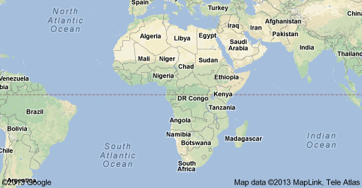
Welcome to Egypt Where is Egypt? North Eastern Africa

Slide 2
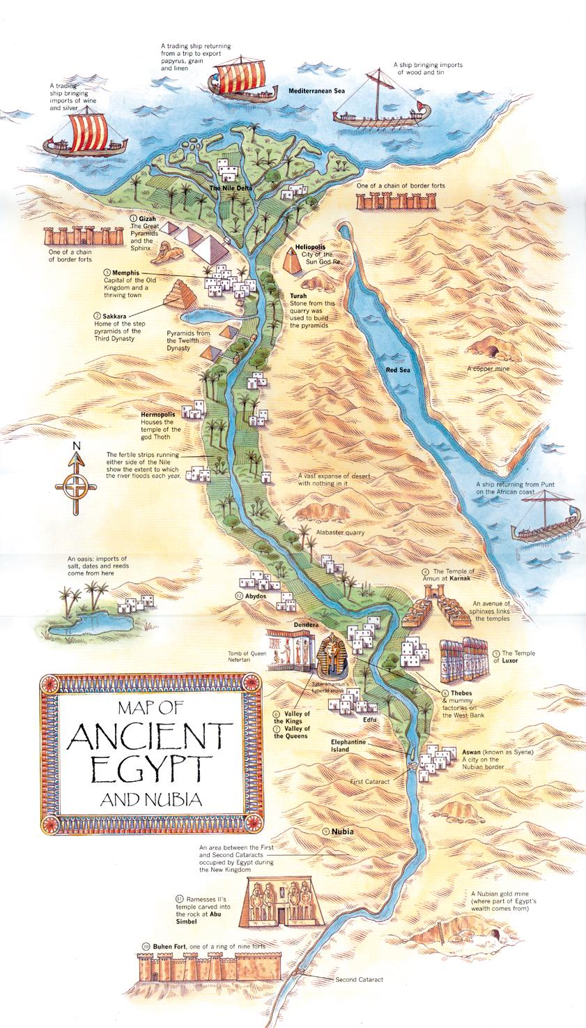
Nile River Location! Location! Location!
__________________
Where the river flows into an ocean, sea, or large body of water.
Rich soil deposits great for farming.
6695 KM
Up to 10 miles wide
6 __________________ (strong rapids & large waterfalls)
______________________________
Libyan Desert to the West
Nubian Desert to the South/East
Arabian Desert to the East
Close to the _________________________and the Red Sea

Slide 3
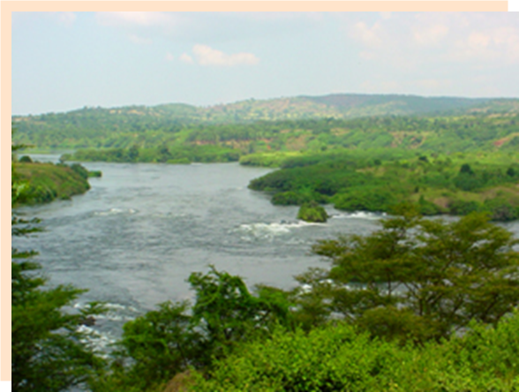
Thanks to the Nile, the development of Egypt was fairly simple. The river (the lifeblood of Egypt) provided:
1. ________________ - Regular, predictable flooding; silt was deposited; 2 crops per year
2. _________________ – water diverted into fields; harvest would occur during the dry season
3. __________________ – during flood season, river flowed north; wind blew south

Slide 4
Religion
___________________ – 28 gods, anthropomorphic; having human characteristics.
Believed in a great after life – Pharaoh would become a god; commoner would stay the same; slaves could gain freedom/property
Brought much with them into death; tried to preserve bodies… _______________________

Slide 5
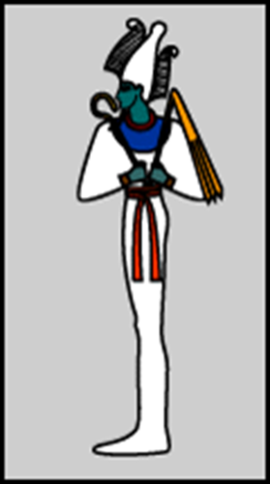
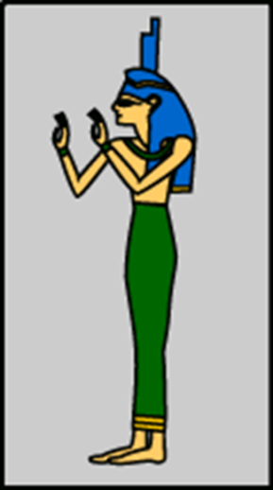
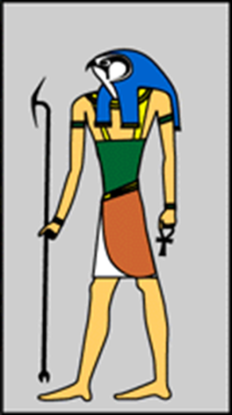
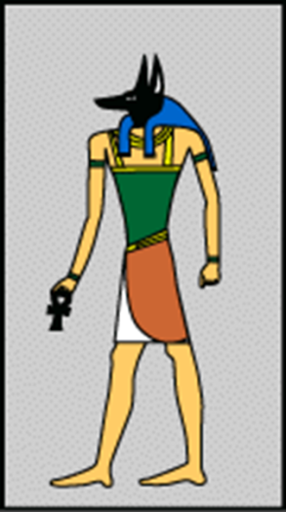
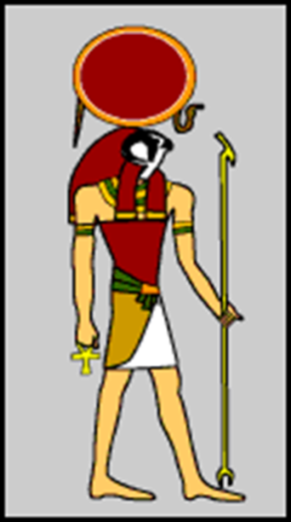
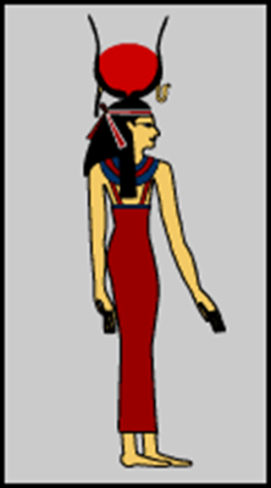
Egyptian Gods KNOW 2 of these!
Osiris –
Isis –
Horus –
Anubis –
Ra (Re) –
Hathor –
Notes:
Horus is the son of Osiris and Isis
Anubis - head of a jackal
Man with hawk head and headdress with a sun disk
Ra was the sun god. He was the most important god of the ancient Egyptians. The ancient Egyptians believed that Ra was swallowed every
night by the sky goddess Nut, and was reborn
Thoth (not shown) – god of writing and knowledge

Slide 7
After death, corpses of ordinary people were placed in ________________________ where they were naturally preserved.
Pharaohs and nobles were mummified to ensure their preservation.

Slide 8
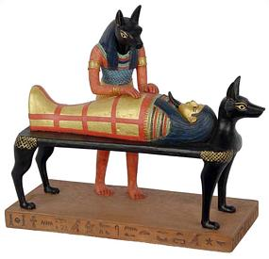
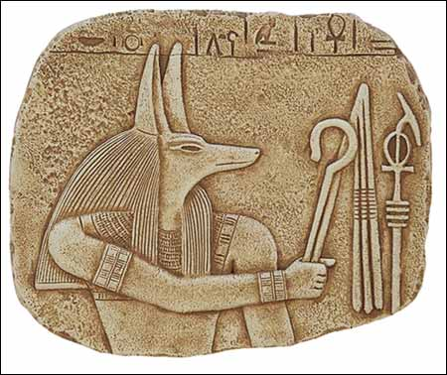
1) Began with a ____________________ with priests and the representatives of certain gods, particularly _____________________.

Slide 9
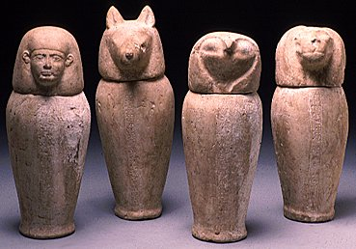
2) Organs were removed and placed in containers: canopic jars. ______________________________________________________________________________________

Slide 10
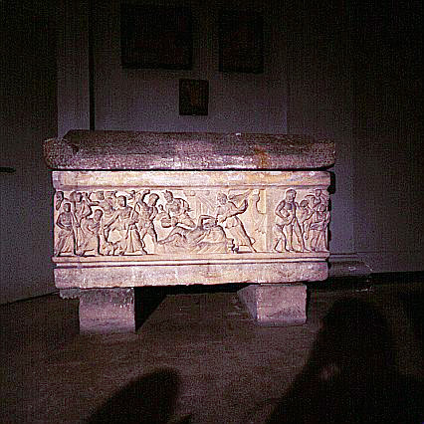
3) Bodies were filled with a substance called “____________”. (salt)
4) Once preserved, the bodies were wrapped in ___________________… later covered in a mask.
5) Then placed in a box called a _________________________.
6) Finally, placed in a ____________________________.

Slide 11
Mummified Animals
Some have been found in large quantities, while others are rare.
Many species were raised in the temples to be sacrificed to the gods.
Autopsies on cats show that most had had their necks broken when they were about two years old.
Cats were highly valued members of the ancient Egyptian household.

Slide 12
Social Structure
____________
____________________________
_____________________
________________________________
____________________
____________

Slide 13
Pharaoh
________________, stood at the top of the social pyramid
Owner of all lands and citizens
_________________
High priest of all gods

Slide 14
King Tutankhamun
Originally Tutankhaten
The “Boy Pharaoh”
Became pharaoh of Egypt at age 9 – died mysteriously at 18
Lived in Memphis
Tomb discovered in 1922 by Howard Carter
Didn’t accomplish much in his reign; famous because his tomb was found intact

Slide 15
Nobles & Military Leaders
Held ____________________ in the administrative departments of Ancient Egypt
Looked after the storehouses of a god
Served as _______________ to the pharaoh
Supervised engineering and construction work for the government

Slide 16
Priests & Scribes
_________________________ of ancient Egypt
Religious functions (that could not be looked after by the pharaoh) were delegated to the priests
Scribes were ranked among the more important members of the kingdom.
____________________________, kept records, wrote reports, educated the young, and organized rations for the armies.

Slide 17
Craftspeople
Earned a living in careers like:
________________
Sandal-making
________________
Incense moulders
Potters
Brick-makers
________________
Carpenters
Stonemason
________________
Goldsmiths

Slide 18
Peasant Farmers
Majority of the population
Most were _____________
They were paid just enough to get by… some even may have been jealous of a slaves.
Often paid high taxes
Were required to _________________________on irrigation systems, constructing tombs, temples and other buildings.

Slide 19
Slaves
_________________ of war brought back by the armies
Female and child slaves = housework for wealthy people
Male slaves worked as ______________, farmers or maintenance labourers around Egypt.
Slaves could _________________________or rent land, and could be set free if owner agreed to it.

Slide 20
Hieroglyphs (sacred carvings)
___________________ – system of writing
Hundreds of symbols (pictographs, ideographs, phonographs)
No spaces or _________________
Could be read in any direction; artists faced pictures in the direction to follow
Written by _______________
Possibly influenced by ________________________

Slide 22
Rosetta Stone CODE BREAKER!
Found in 1799 by French Soldiers
Jean Champollion deciphered it in 1822.
Three kinds of writing found on it
__________________
__________________
__________________

Slide 23
Notes:
Egyptian Alphabet

Slide 24
The Pyramids
Pyramids are __________________________built as tombs for the pharaohs
Mostly during the Old Kingdom (2700-2200 BCE).
The __________________ would bring things they needed in the next world.
Largest pyramids are found in the city of ___________.
Built in ___________________: largest for pharaoh; smaller for family; mastabas for his officials (flat rectangles)

Slide 25
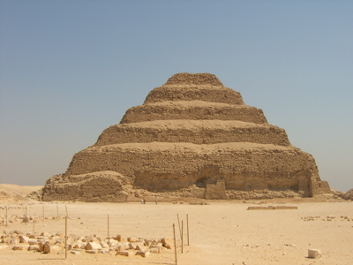
3 different types:
1. ________________- One mastabas under another

Slide 26
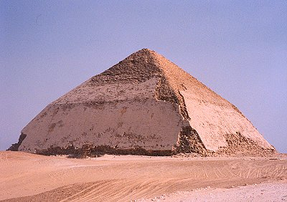
2. ______________________

Slide 27
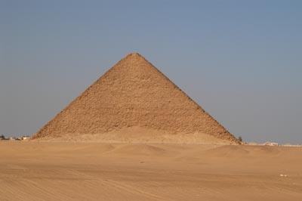
3. ____________________

Slide 28
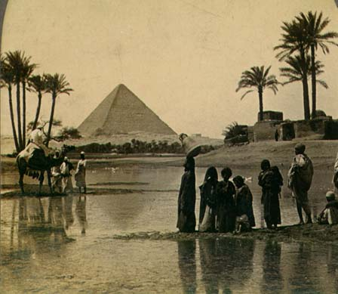
The Great Pyramid of Giza

Slide 29
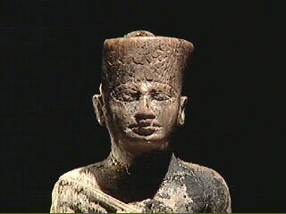
Ancient Wonder of the World
Built by _____________________ (2540 BCE)
Seen as a symbol of _____________ of the pharaohs of the Old Kingdom

Slide 30
Feat of Architecture
Made up of chambers, passages, and vents
________________________________
Contains approx. 1,300,000 limestone blocks weighing 20-30 tonnes each (up to 70 tonnes!)
________________________________
Perimeter forms a near perfect square
Sun sets between 2 Pyramids on summer solstice
Shafts lined up to view certain constellations
________________________________

Slide 31
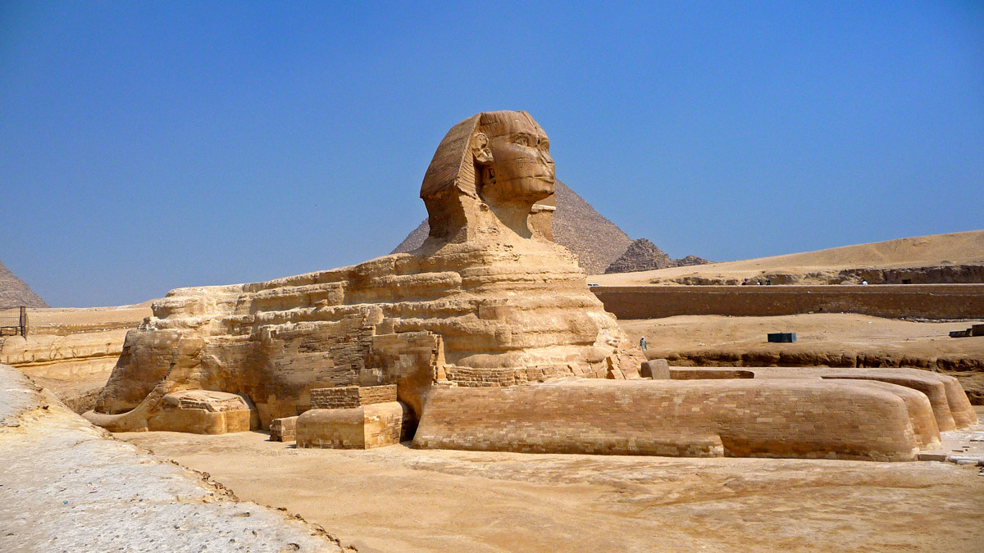
The Sphinx
_____________________________________________
Possibly Khufu’s son Kafre (had it built)
Possibly guarding the pyramid
_____________________________________________

Slide 32
The Decline of the Egyptian Empire
In-fighting amongst the nobility: ________________________ and murders weakened and destabilized the position of pharaoh.
Egypt, once again, became vulnerable to foreign powers.
______________________ – Alexander the Great marched into Egypt in 332 BCE and took over.
______________________ 48 BCE– Cleopatra was the last pharaoh and fell to the influence of Romans Julius Caesar and Marc Antony.

