Slide 1
The Population Problem
World Issues 120

Slide 2
What do you think?
Why would POPULATION be considered a problem?
Why would POPULATON be considered a WORLD ISSUE?
Canada doesn’t appear to have a POPULATION problem; why should we care?

Slide 3
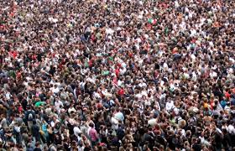
Population Quiz:
How much do you already know about population?

Slide 4
Population Changes
Since 1945, the world has experienced rapid, uneven population growth.
This has sparked debate over the carrying capacity of the planet, the consequences of unrestrained population growth, and measures that can be taken to keep the world’s population in check.

Slide 5
“Don't speak to me of shortage. My world is vast
And has more than enough-for no more than enough.
There is a shortage of nothing, save will and wisdom;
But there is a longage of people.”
-Garrett Hardin (1975)

Slide 6
What is population growth?
Population growth is change in population over time or the change in the number of individuals in a population per unit time.
Population Growth Rate is the rate at which the number of individuals in a population increases.
The population growth rate has increased exponentially since humans first landed on the earth millions of years ago.

Slide 7
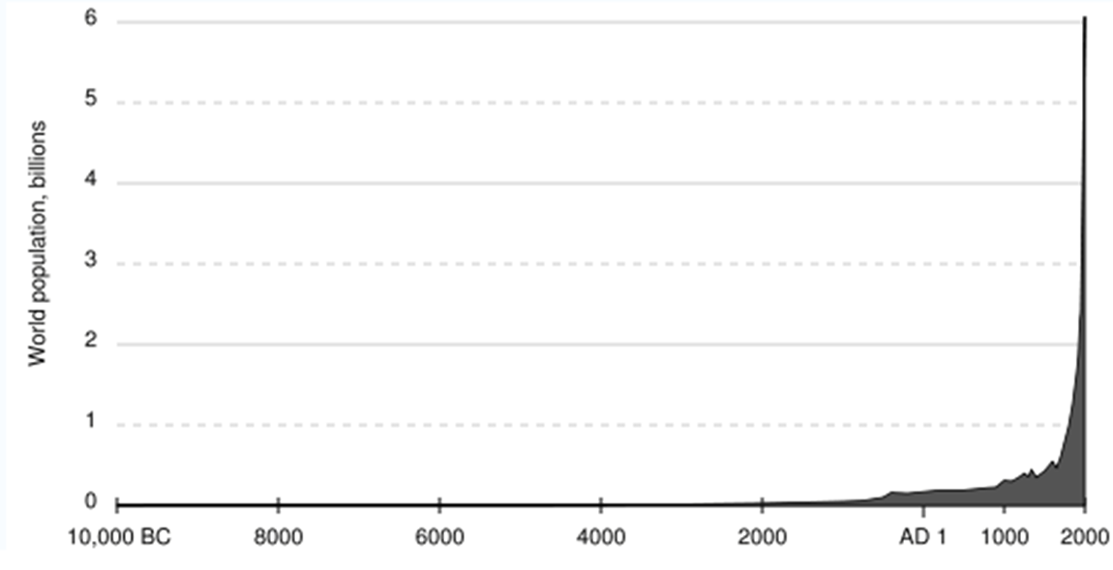

Slide 8
So, what’s the problem?
Issue: overpopulation (2011) (3:40)
https://www.youtube.com/watch?v=CAUVGYz3pZw
Mother: Caring for 7 billion (2011) (2:31)
https://www.youtube.com/watch?v=JPc9BdWVl5s
Population Growth (2010) (5:04)
https://www.youtube.com/watch?v=b98JmQ0Cc3k&feature=youtu.be
*How did we get so big? (2011) (2:33)
https://www.youtube.com/watch?v=VcSX4ytEfcE&feature=youtu.be

Slide 9
Sustainable Carrying Capacity?
The main problem: there will not be enough resources on our planet to serve the people.
By 2050, we’re expected to reach 9 to 10 billion.
Some “Experts” say that our sustainable carrying capacity (for everyone to live comfortably – not in U.S./Canadian style—with our available resources) is 2-3 billion.

Slide 10
8 Overpopulation causes
Improved Technology/Industrialization
Increased Economic Development
Better medicine, vaccines, access to hospitals, better maternal health care…
longer life expectancy
lower infant mortality rate

Slide 11
Overpopulation continued…
Attitudes – some cultures (ex. Sub-Saharan Africa) tend to favour large families
Why? – work on family farms, enterprises
Take care of parents in old age
More sons = more economic potential
Fear of infant mortality
Globally attitudes have been changing steadily (ex. Latin America, Asia)
Not enough access to family planning and contraception (ex. Available to 40% of those who want it in Sub-Saharan Africa and 70% in Asia – source: World Bank Report)
Or fear of side-effects
Or fear of husbands/partners

Slide 12
Overpopulation continued…
Lack of education
Few rights (legal, civil, religious, social) for women
Population Momentum

Slide 13
Population Pyramids
To help make population projections for different countries, demographers look at a profile of the country’s residents.
What are the ages of the people?
How many men? How many women?
Using this information, they construct a graph called a population pyramid.
Represents the age & gender structure of a population using a bar graph
Shows rate of population growth or decline
Births, deaths, and migration shape the pyramid
It is a graphic representation of 100% of a country’s population

Slide 14
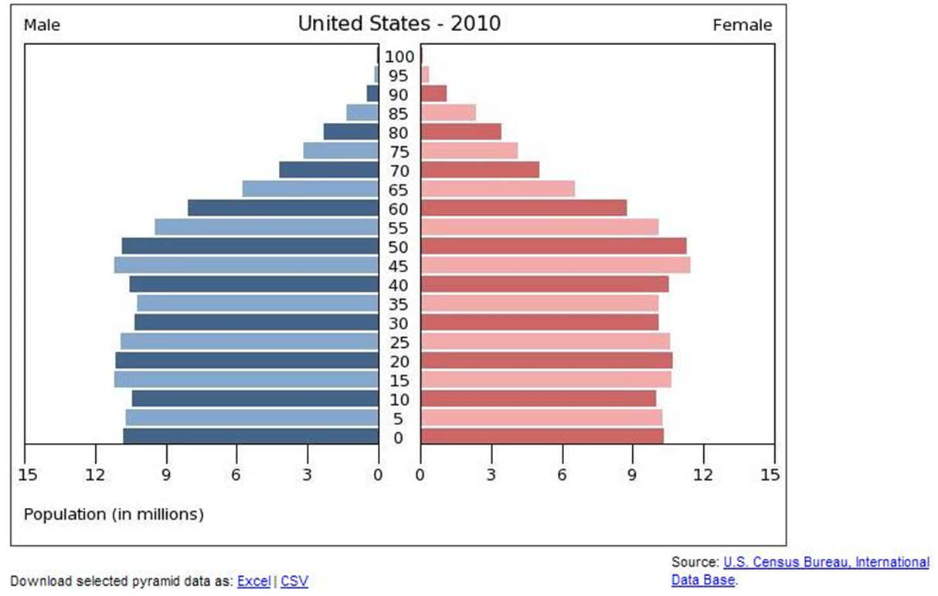
A Population Pyramid
There are three types of patterns shown with Population Pyramids:
Rapid growth
Slow growth
Negative growth

Slide 16
Assignment: Reading Population Pyramids
Study the pyramids from various countries and answer the questions on the sheet provided.
Using the data from the 2015 Stats Canada information, make your own population pyramid.
Set it up based on the examples.
Points will be given for accuracy and neatness.
Don’t forget to label it and add a title.

Slide 17
Population Theories: Has population always been a problem?
Confucius – Land could support only a limited number of people, but migration would occur before the natural population checks of war and famine
Aristotle & Plato – large population provides a military advantage – helps with the warring Greek city-states…If population grows too big, create a new city-state
Ancient Romans – grow as big as possible to defend borders
Early Christians – large families to offset high death rates caused by famine, pestilence, and war… (Middle East?)

Slide 18
“One would have thought that it was even more necessary to limit population than property...The neglect of this subject, which in existing states is so common, is a never-failing cause of poverty among the citizens; and poverty is the parent of revolution and crime.”
--Aristotle

Slide 19
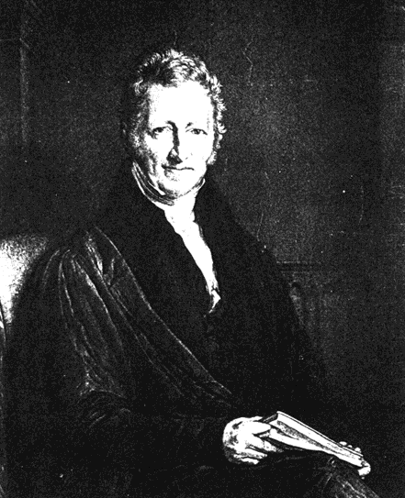
Recent theories:
Thomas Malthus (1800s)
Influenced by the rapid growth of cities during the Industrial Revolution
Thought overcrowding would destroy the quality of life;
Population increases exponentially while food supply increases algebraically
The food supply would be unable to meet the demand and poverty and famine would result.
He failed to see the technological advances which resulted from the Industrial Rev….but it may still happen later on.
Thomas Malthus
(most famous population theorist)

Slide 20
William Catton (1982)
An overshoot condition occurs when the population growth rate exceeds the planets carrying capacity. At this point, the population will start to die out and eventually even out with the carrying capacity again.
We need a sustainable economy, where the needs of the population are balanced against the health of the environment. We can no longer just expand into underpopulated regions.

Slide 21
Migration
We are also seeing the impact of migration from rural areas to urban areas.
In what other time period in history did this occur?

Slide 22
What Makes People Migrate?
Push factors: Factors that cause people to leave an area
Low wages
Shortage of work or food
Overcrowding
Political persecution
Crime
War
Environmental degradation

Slide 23
What Makes People Migrate?
Pull factors: Factors that cause people to go to an area
high wages
high standard of living
educational opportunities
freedom
lots of resources

Slide 24
How Events affect population
Wars can decimate a generation of men.
New medicines can reduce or eradicate disease, extending life expectancy.
Population changes may be a warning sign of other important changes (ex. environmental)

Slide 25
Emigrants: people who move from a country
Immigrants: people who move to a country
Each year, over 2 million people migrate and settle permanently in a new country.

Slide 26
Types of migration
voluntary/involuntary
permanent/temporary
legal/illegal
international/internal

Slide 27
Voluntary Migration
movement of people by their own free will
During the Industrial Revolution, 70 million Europeans left for Canada, the USA, Australia, etc.
This is known as “good” migration – people moving to where there are more resources and opportunities.

Slide 28
Involuntary Migration
movement of people against their will
Ex: up to 15 million Africans involuntarily migrated during the slave trade years.
2 causes: political (war, persecution, etc.), or environmental (drought, climate change, etc.)
This is known as “bad” migration.

Slide 29
Permanent/Temporary Migration
In the past, most migration was permanent
Now with the ease of travel, it is often temporary.
Many countries (e.g. Germany) do not allow much permanent settlement and only allow people to come work in the country temporarily.

Slide 30
Permanent/Temporary
Refugees: people fleeing from danger
some are permanent, but many countries expect them to return to their country of origin once conditions improve.

Slide 31
Legal/Illegal Migration
Legal: Countries accept people according to the rules that they have set.
Illegal: people either “sneak” in or don’t leave when they are supposed to.

Slide 32
Canadian Requirements
Canada has 5 requirements for immigration. A person must meet one of these requirements:
Skilled worker: well-educated, desired trade
Investor/entrepreneur: have money to invest or able to start their own business
Family reunification: already have immediate family permanently settled here
Provincial Sponsorship: provinces can ask for people with special skills that will fill a need
Refugees: a true refugee claim (often denied)

Slide 33
International/Internal
International migration is a change of residence over national boundaries.
Internal migration occurs within a country’s borders.
Does Canada experience this?
Most common: rural to urban migration
Canada’s internal migration rate has stabilized and we are at about 80% urban, 20% rural.

Slide 34
Impacts
The Brain Drain - developing countries are losing their “best and brightest” to emigration.
In many poor countries (Haiti, Ghana, Mozambique), 50-80% of college/university grads leave for other countries.
Is there a solution to this problem?

Slide 35
The Demographic Transition Model

Slide 36
“Demographic Transition Model”
Demographic transition model: a hypothetical model that illustrates the stages of trends relating to human populations - their size, distribution, composition, and development.
A line graph that shows birth and death rates in a given country.
It shows the average number of births/1000 people in a year and compares it to the average number of deaths in the same year.
Birth rate – death rate = rate of natural increase
Categorizes population growth into 5 stages.

Slide 37
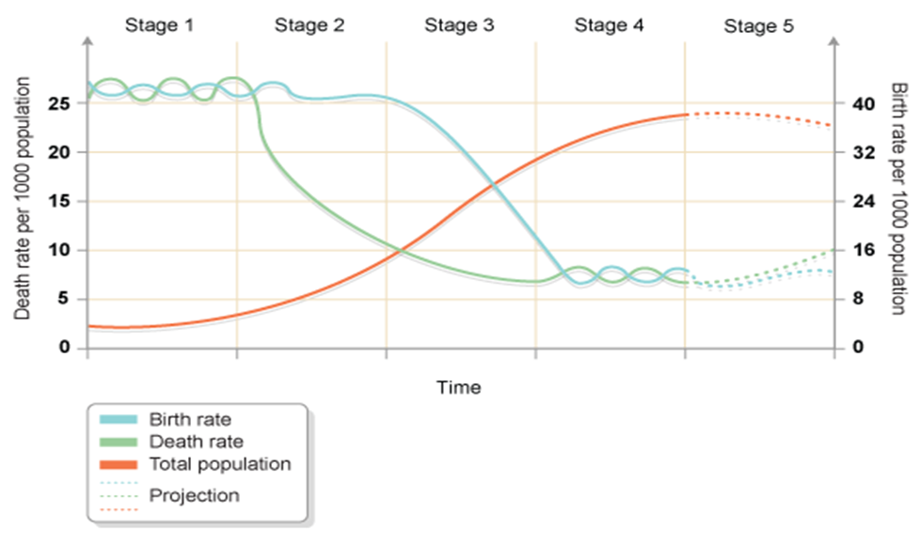

Slide 38
Stage 1: Pre-transition High Birth Rates & High Death Rates = Low overall population growth (but periods of fluctuation)
Possible reasons for this:
little access to birth control
many children die in infancy (high infant mortality) so parents tend to have more children to compensate in the hopes that more will live
children are needed to work on the land to grow food for the family
children are regarded as a sign of virility in some cultures
religious beliefs (e.g. Roman Catholics and Hindus) encourage large families
high death rates among children because of disease, famine, poor diet, poor hygiene, little medical science.

Slide 39
Stage 2: Early Transition High Birth Rates + Low Death Rates = High (large) population growth (population explosion)
The reasons for this could be:
improvements in medical care - hospitals, medicines, etc.
improvements in sanitation and water supply
quality and quantity of food produced rises
transport and communications improve the movements of food and medical supplies
decrease in infant mortality.

Slide 40
Stage 3: Late Transition Birth rates start to fall + death rates continue to decline = Population still increasing rapidly, but begins to steady.
The reasons for this could be:
increased access to contraception
lower infant mortality rate (less need to have a bigger family )
technology means fewer laborers are required
the desire for material possessions takes over the desire for large families as wealth increases
equality for women means that they are able to follow a career path rather than feeling obligated to have a family.

Slide 41
Stage 4: Post-Transition Low birth rates + low death rates (fluctuating with 'baby booms' and epidemics of illnesses and disease) = steady population
Stage 5: ??
Birth Rates have fallen below death rates = population decline (natural decrease) Ex. Germany and Japan

