Slide 1
Canada and the World
The horrors of the Second World War made ​​the world say “never again”!
Canada wanted to play a greater role in international affairs. We signed alliances for protection of another war.

Slide 2
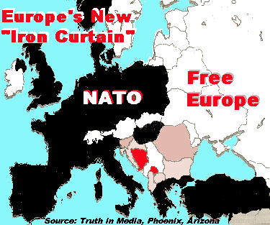
Canada and the Cold War
To meet the concerns to the spread of communism, Canada and other allies have formed the North Atlantic Treaty Organization (NATO).
The aim was to ensure collective security .

Slide 3
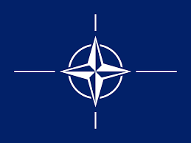
NATO North Atlantic Treaty Organization
NATO’s essential purpose is to safeguard the freedom and security of its members through political and military means.

Slide 4
North Atlantic Treaty Organization
NATO was formed in 1949
This is a common defense system.
This means that each country promises to always help the other members of NATO who are attacked or threatened.
Canada was one of the first members in 1949
By doing this, Canada has shown the world that he was an ally of the United States, and he was ready to participate in world affairs
So, if the countries of Western Europe would have been overrun (Invaded) during the Cold War, Canada was involved in the beginning.

Slide 5
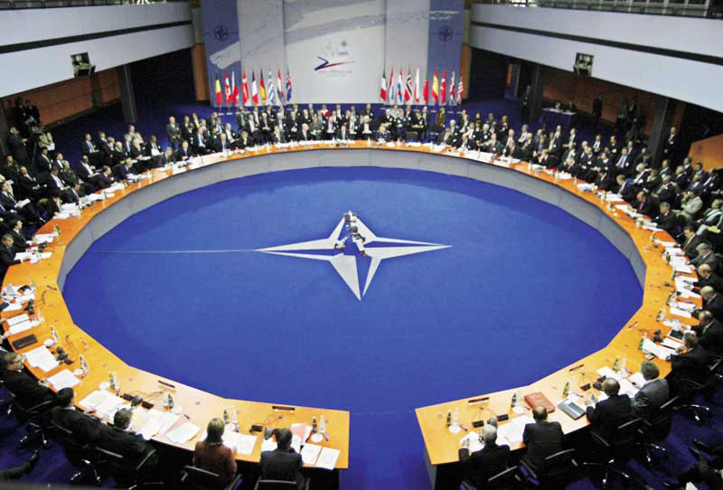

Slide 6
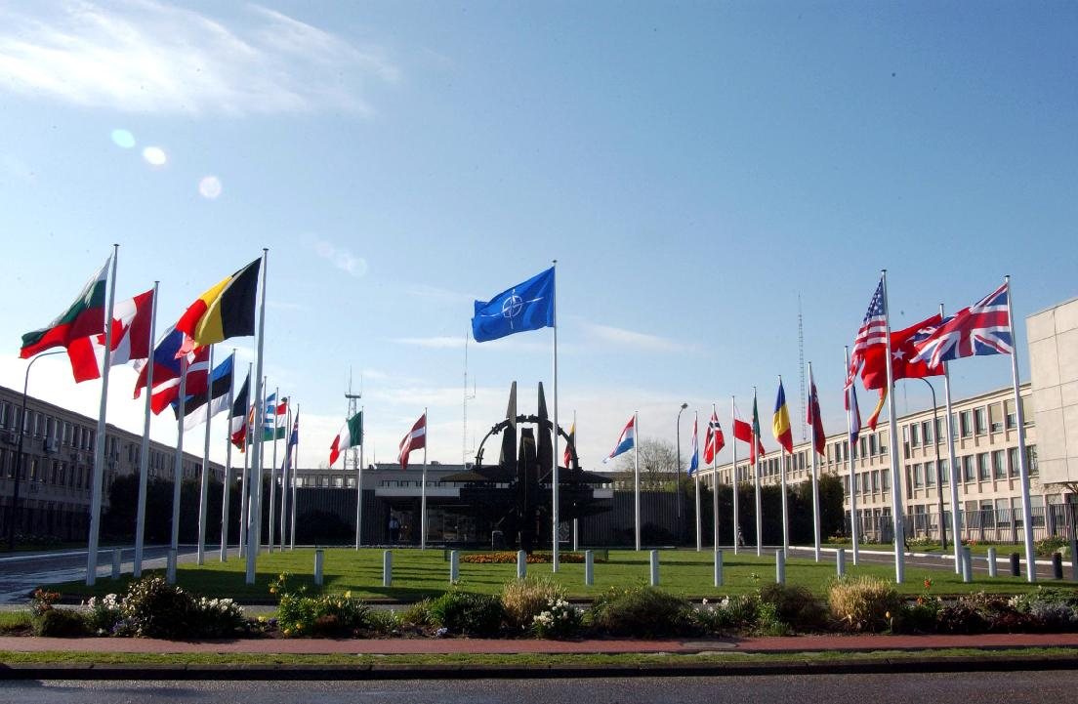

Slide 7
https://www.youtube.com/watch?annotation_id=annotation_1243947603&feature=iv&src_vid=MkqFg7HIpEg&v=f-swJe4F0mk
(7:14)

Slide 8
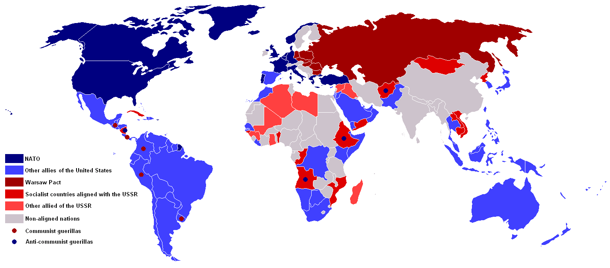
As an answer to NATO, the Soviet Union established the Warsaw Pact: the military alliance between the communist countries in Europe.
This will include:
Albania Bulgaria Czechoslovakia Hungary Poland Eastern Germany

Slide 9
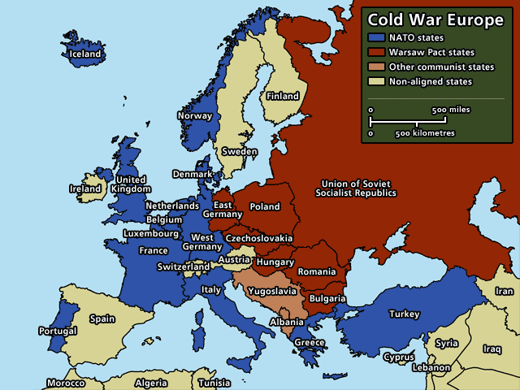

Slide 10
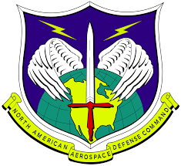
NORAD North American Aerospace Defense Command
A bi-national (US & Canada) organization in charge of the missions of aerospace warning and aerospace control for North America.
Aerospace warning includes the detection, validation, and warning of attack against North A. whether by aircraft, missiles, or space vehicles.

Slide 11
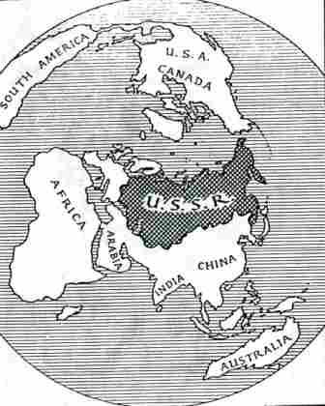
Northern Canada was a strategic place because the shortest route to attack the US would be the Arctic Ocean. So Canada and the United States have agreed to cooperate in an air defense.

Slide 12
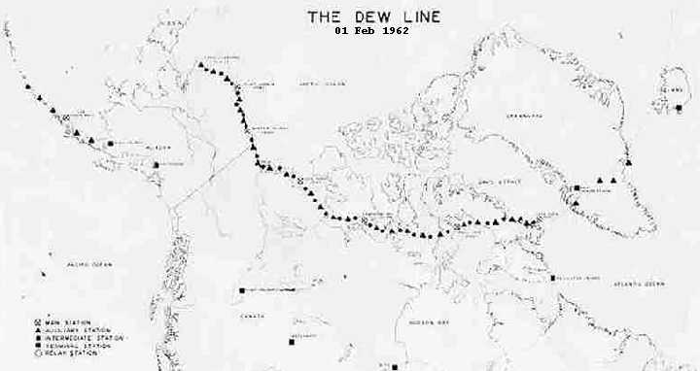
Canada and the United States have built a series of 63 radar stations called the Distance Early Warning (DEW ).

Slide 13
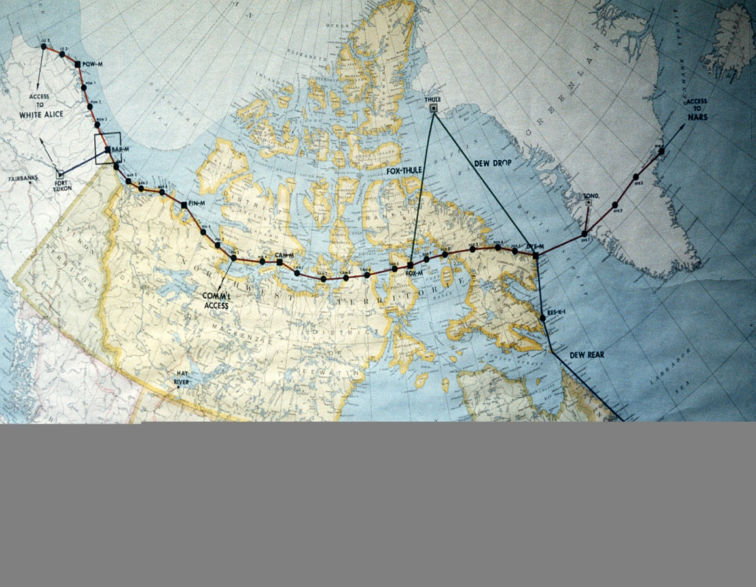
This causes controversy in Canada because Canadians thought that the important decisions of the defense were taken in the United States .

Slide 14
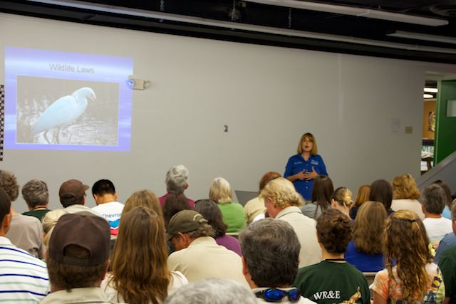
DEW has created thousands of jobs. However, after the Cold War, radar stations have closed.
Many Inuit have lost their jobs and their traditional way of life was influenced because the construction was not good for the animals.

Slide 15
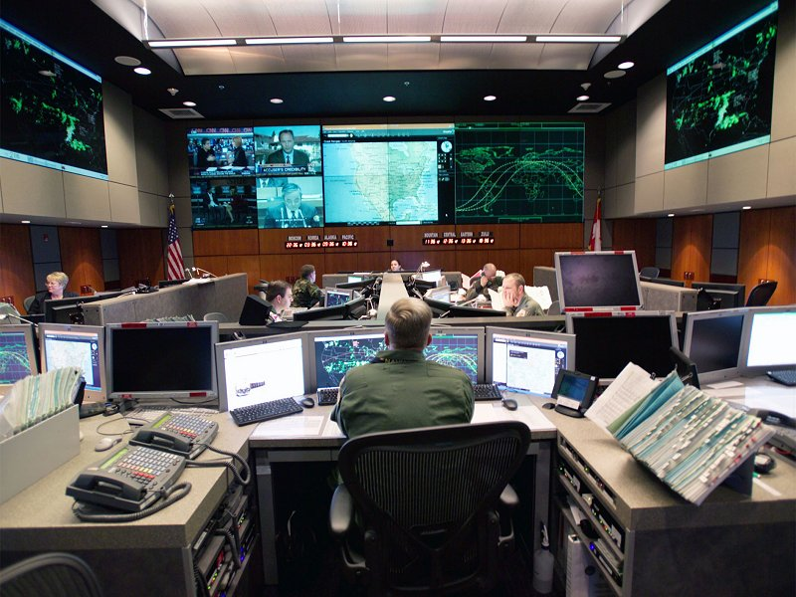

Slide 16
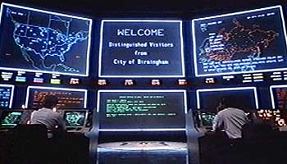

Slide 17
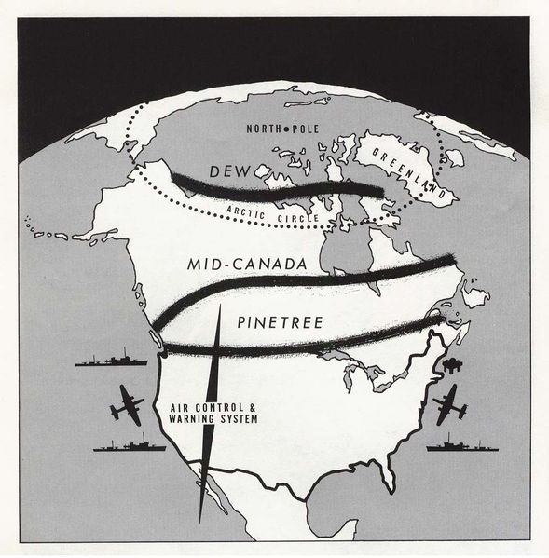

Slide 18
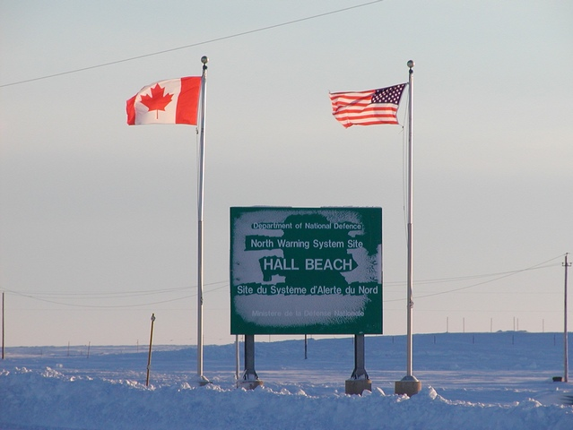
Notes:
Entry site to DEW Line

Slide 19
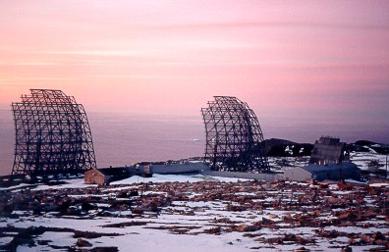
DEW Line Site
Notes:
DEW line site

Slide 20
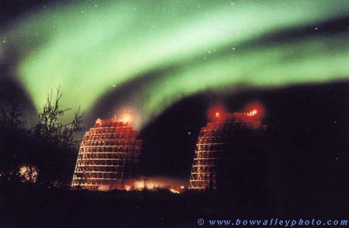
Notes:
Dew Line Site / Yukon River on Arctic Circle, Alaska

Slide 21
http://www.youtube.com/watch?v=y3cQUGhLmFw
(3:50)

Slide 22
UN United Nations
An organization established in 1945 by 51 countries that promotes international co-operation in order to prevent another conflict like World War 2.
The 193 countries that are involved today can take action on the issues confronting humanity in the 21st century like:
- peace and security - climate change - Disarmament
- human rights - Terrorism - humanitarian
- health emergencies - gender equality - Governance
- food production - sustainable development

Slide 23
Their objectives are:
To work collectively to bring the end of war.
To foster cooperation among nations.
To improve the way of life in all countries.
To promote human rights.
https://www.youtube.com/watch?v=M0_kxsCFZOQ (15:59)

Slide 24
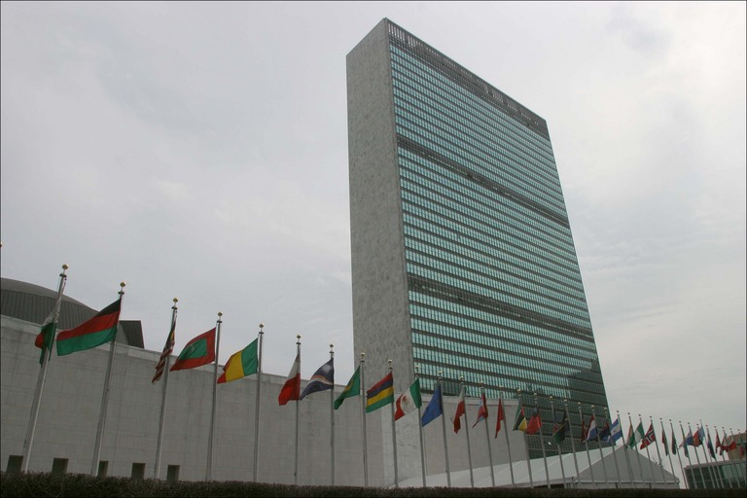

Slide 25
http://ed.ted.com/featured/FtDrQ8xK (2:00)

Slide 26
Where does Canada fit into the UN?

Slide 27
Canada is more than just a United Nations member - due to conflicts, we are a very important member .

Slide 28
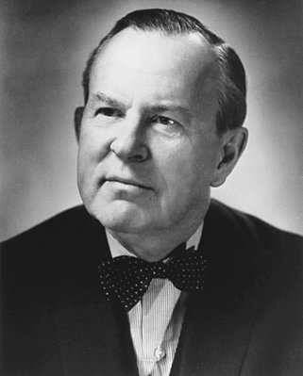
Lester B. Pearson, the Canadian Minister of External Affairs at this time, had a plan to calm the situation. He establish a United Nations force that would be responsible for keeping the peace. As a result, a "UN Peacekeeping Force" went and was able to keep the Soviet Union and other countries away from each other while an agreement was established.

Slide 29
Pearson was awarded the Nobel Prize for Peace in 1957. Since that time, Canada has participated in almost every Peacekeeping mission for the United Nations.

Slide 30
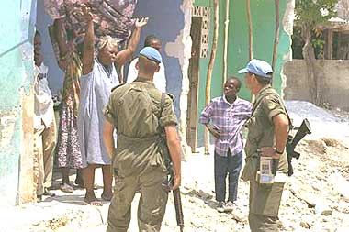
Notes:
Haiti

Slide 31
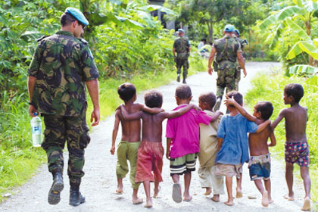
https://www.youtube.com/watch?v=jAXVbtdBu10
Notes:
East Timor

