Slide 1
6 Major Events

Slide 2
The Cold War lasted until 1989.
There were 6 major events that have almost started another world war:
Berlin 1948-1949
Hungary 1956
Cuba 1962
Vietnam 1963-1975
Czechoslovakia 1968
Afghanistan 1979-1989

Slide 3
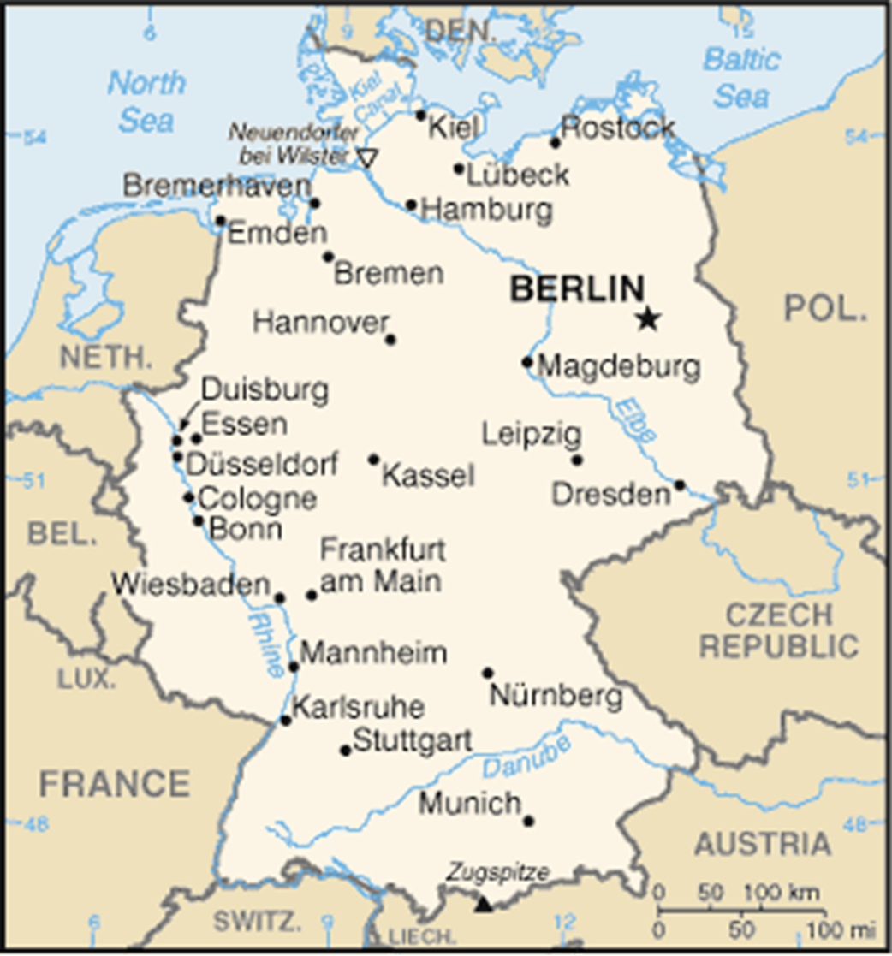
Berlin 1948-1949 After World War II, Germany was divided into occupation zones by the Allies. Berlin was divided between France, Grade Britain , the United States and the Soviet Union.

Slide 4
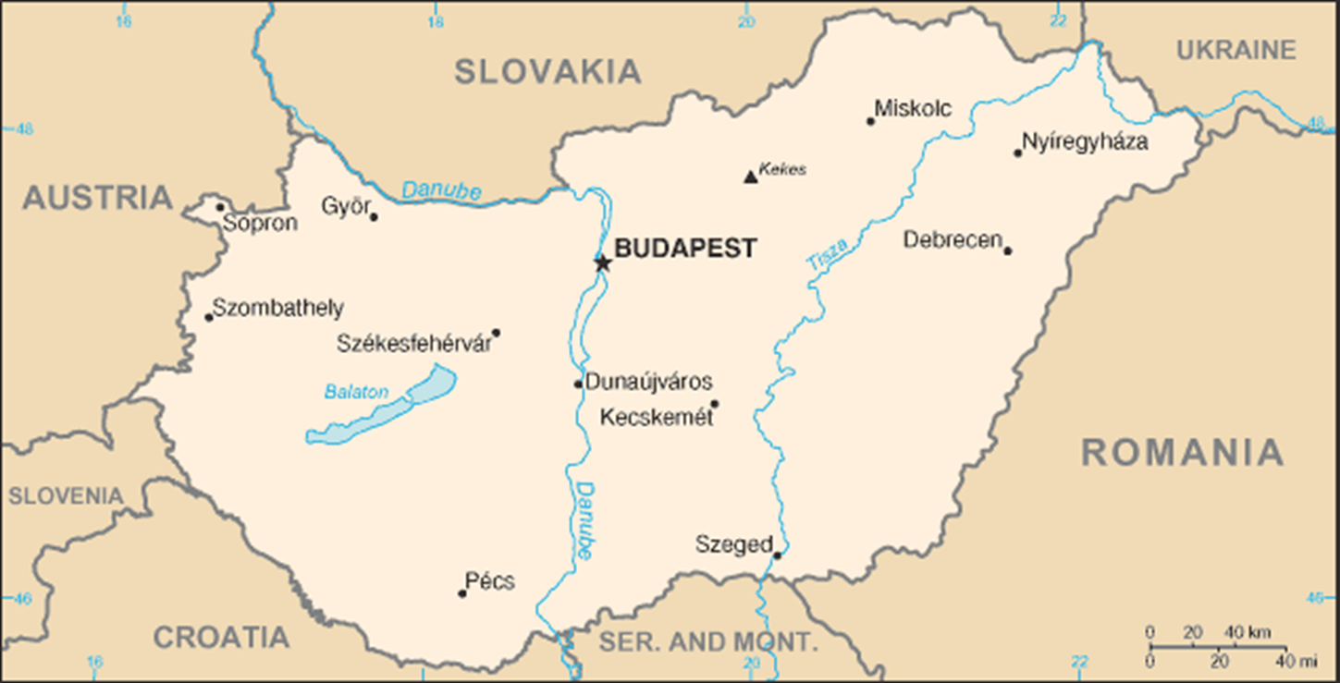
Hungary 1956 - The Hungarians removed their pro-Soviet government and made liberal reforms. The Soviet Union sent 200,000 troops to invade Hungary and stopped the resistance. The Allies have given verbal support only - no military aid.

Slide 5
3. Cuba – 1962 (Cuban Missile Crisis)
In 1962 the world came very close to a third world war.
A group of Cubans were not happy with their government and gathered a group of Americans to attack the Bay of Pigs.
Then, as retaliation, Cuba allied with the Soviet Union and the Soviet Union planted missiles on the island of Cuba pointed in the US direction.
The United States discovered this by aerial photos. After several threats and a lot of tension and discussion, the missiles were removed.

Slide 6
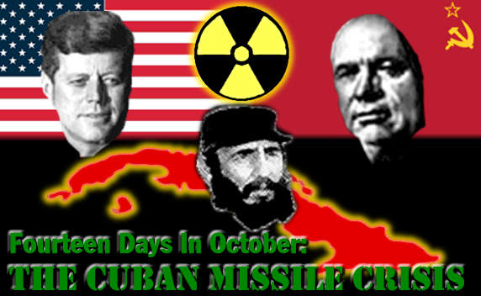

Slide 7
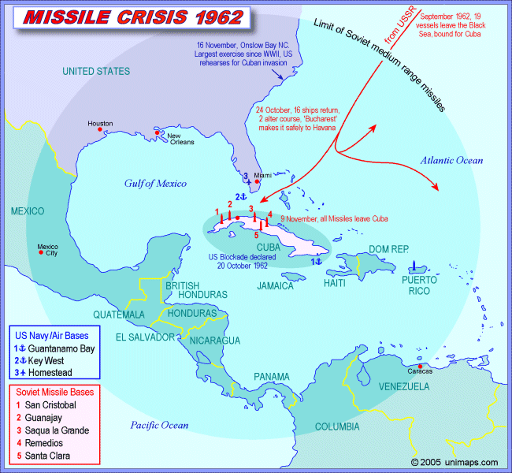

Slide 8
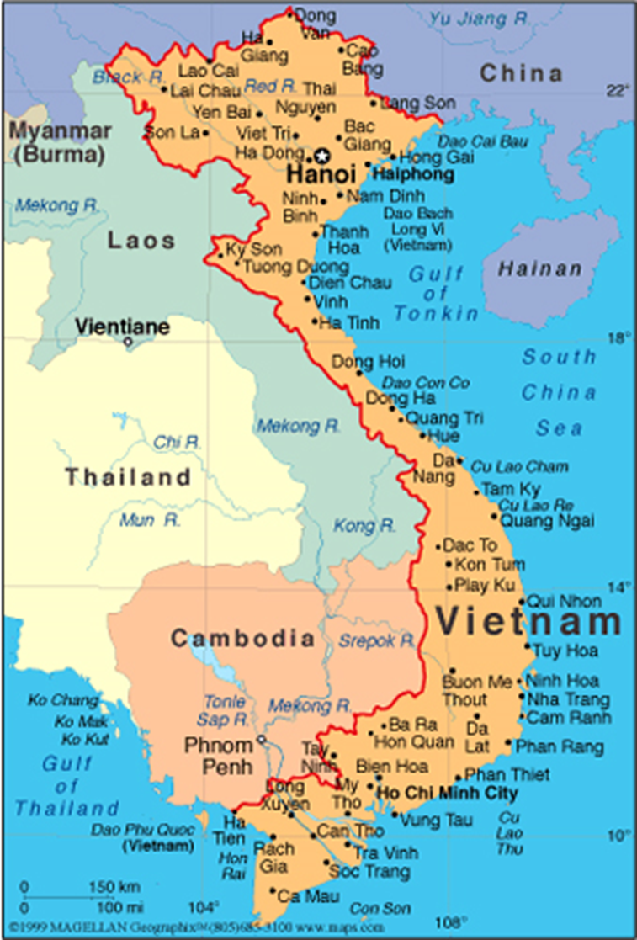
Vietnam 1963-75
After WWII, France tried to regain control of Vietnam. The Vietnamese wanted independence and fought the French. (The French lost.)
As a result, Vietnam was divided between North Vietnam (communist) and South Vietnam (non-communist ).
The North Vietnam invaded South Vietnam in trying to bring the country under a single government. The US sent soldiers to help the South.
Because of the anti- war ideas in the US (and because they could not win) the US took their troops out in 1975.
The North Vietnam convinced the South to become a communist country.

Slide 9
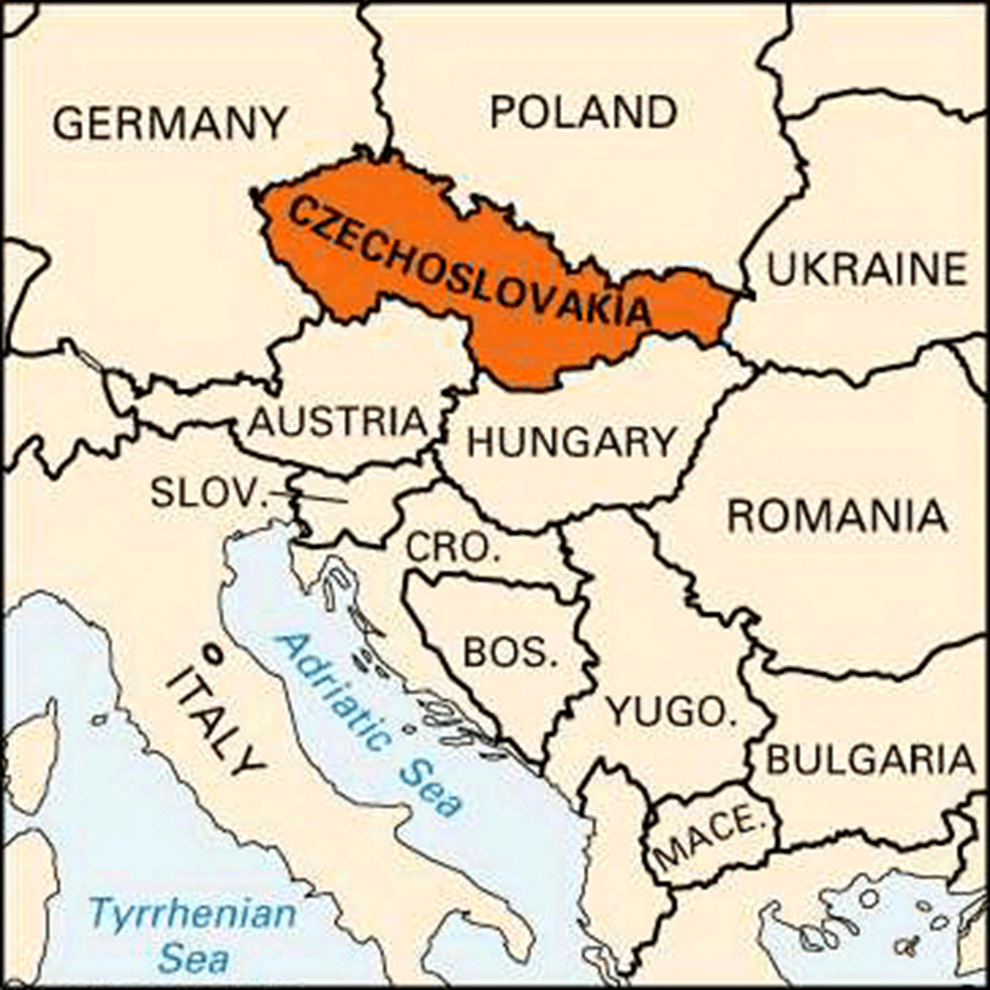
5. Czechoslovakia in 1968
Czechoslovakia began to reject the communist government in favor of a more liberal system.
This event is known as the Prague Spring.
The Soviets invaded Czechoslovakia and restored the Communist government The allies condemned the action of the Soviets , but did nothing.

Slide 10
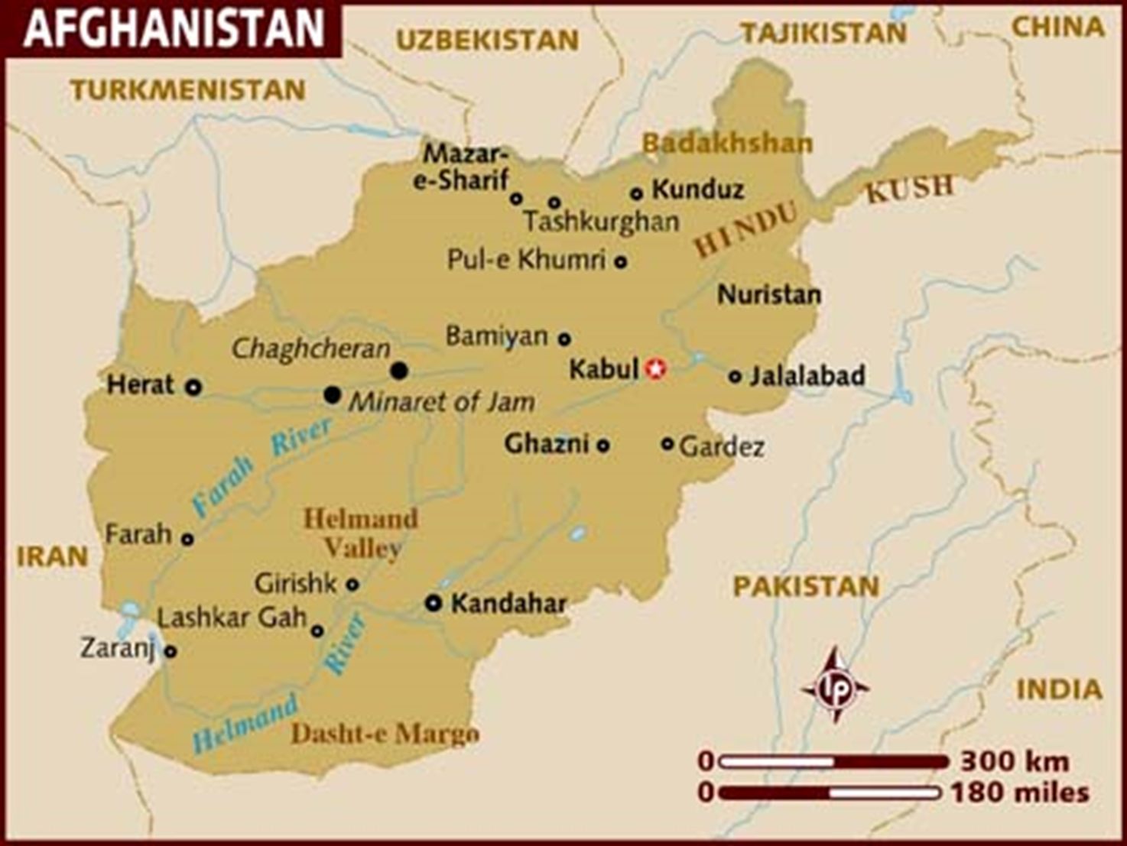
6. Afghanistan 1979-89
Civil war broke out between the communist government and Muslim guerrillas (irregular army)
The Soviet Union sent troops to help the communist government.
As a result, the US sent aid to guerrillas. The Soviets did not win and withdrew the troops in 1989.
The civil war continued until the Taliban took control in 1996.

Slide 11
https://www.youtube.com/watch?v=wVqziNV7dGY

